Slide 1
Activity Directions
Get into groups of 4.
Have each person in the group choose one of the following slides to work with. Each slide has a statement at the top declaring some object to be a computer.
Each person should read the statement on the top of their slide and fill out the box in the upper left corner with a reason explaining why the statement is true.
Everyone should pass their paper to the group member to their left.
Now everyone fills out the second box in the upper right hand corner with a reason explaining why the statement is false.
Pass papers left again.
Everyone fills out the lower left hand box with a rebuttal to the claim made by the first person.
Pass papers left one more time.
Everyone fills out the lower right hand box with a rebuttal to the claim made by the second person to fill out the sheet.
Discuss what people wrote and debrief the activity.

Slide 2
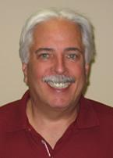
A person is a computer.
Person 1: Why do you agree with the statement above?
Person 2: Why do you disagree with the statement above?
Person 3: Why do you disagree with Person 1?
Person 4: Why do you disagree with Person 2?

Slide 3
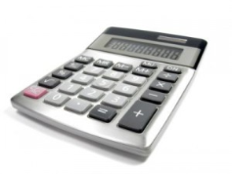
A calculator is a computer.
Person 1: Why do you agree with the statement above?
Person 2: Why do you disagree with the statement above?
Person 3: Why do you disagree with Person 1?
Person 4: Why do you disagree with Person 2?

Slide 4
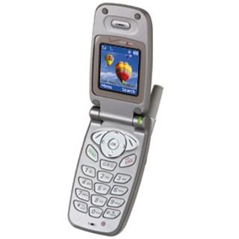
A flip phone is a computer.
Person 1: Why do you agree with the statement above?
Person 2: Why do you disagree with the statement above?
Person 3: Why do you disagree with Person 1?
Person 4: Why do you disagree with Person 2?

Slide 5
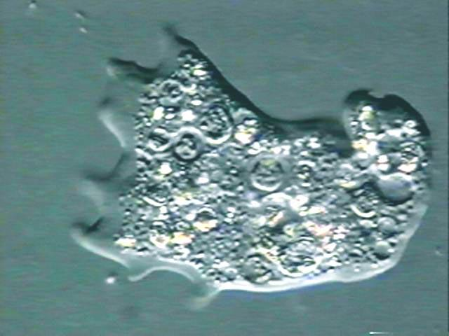
An amoeba (single cell) is a computer.
Person 1: Why do you agree with the statement above?
Person 2: Why do you disagree with the statement above?
Person 3: Why do you disagree with Person 1?
Person 4: Why do you disagree with Person 2?

