Slide 1
CPU
Full name: Central Processing Unit
Skills: handles most system input, like mouse clicks and running applications
Favorite color:
Glow-in-the-dark
Image courtesy of:
Free online computer courses and tutorials for seniors and beginners from www.meganga.com

Slide 2
Hard Drive
Full name: Hard Disk Drive
Occupation: permanently stores all information saved to the computer, then retrieves it later when it is needed.
Favorite hobbies: Reading and writing. A lot.

Slide 3
SSD
Full name: Solid State Drive
Skills: Also permanently stores data, but without clunky moving parts. This makes it much faster than a hard drive.
Favorite Olympic sport:
Sprinting
Image courtesy of:
Intel.com

Slide 4
RAM
Full name: Random Access Memory
When you open a program, it gets loaded from the hard drive into the RAM. RAM is much faster than the hard drive, so this allows your computer to run smoothly. Only temporary things access RAM; anything that is saved permanently is sent back to the hard drive.
Favorite activity: Juggling
Image courtesy of:
http://www.quickboise.com

Slide 5
Optical Drive
Other names: CD Drive
Skills: Loading information from CDs, DVDs, and Blu-Rays, or writing information back onto them
Favorite artist: Taylor Swift
Image courtesy of:
http://www.maximumpc.com

Slide 6
Graphics Card
Also known as: Video Card
Skills: Converts information from the CPU into actual images on your monitor.
Favorite activity: rollerblading
Image courtesy of:
http://news.techgenie.com, author: Harmeet

Slide 7
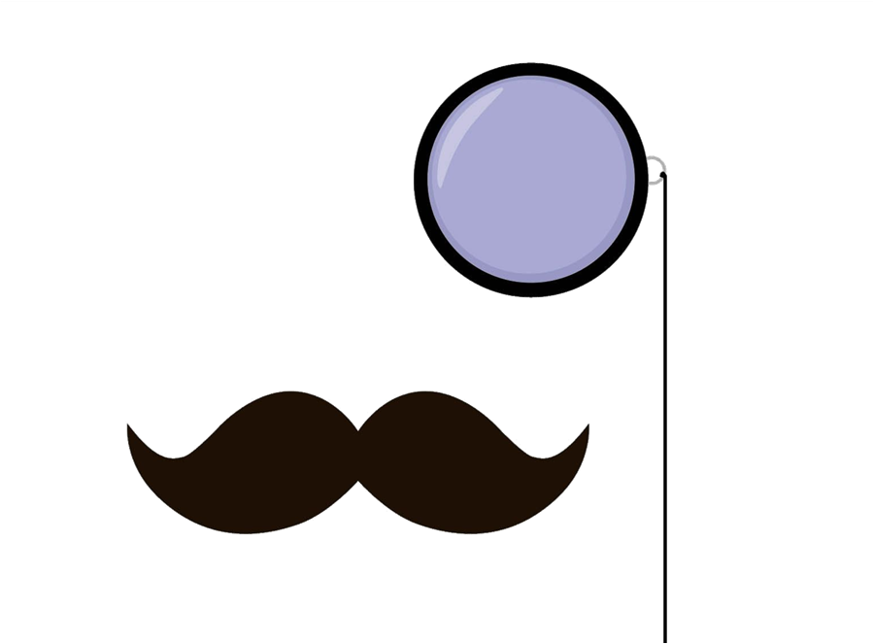
Monitor
Casual Nickname: Screen
Skills: Displays images and applications using tiny dots of light called pixels.
Alter Ego:
Make-up Artist

Slide 8
Motherboard
The motherboard is a circuit board that connects the main parts of the hardware, allowing them to communicate with each other
Favorite activity: Playing board games with her daughterboard.

