Slide 1
Directions
Find a partner.
Pick one person to be the chef and one person to be the artist.
The artist should cut up the “color cards” while the chef cuts up “food cards”.
The artist should then rank the color cards from least favorite to most favorite and record this order on the worksheet on page 6. Do NOT let the chef see what the order is!
The artist should place the color cards facedown in a list on the table in order from least favorite to most favorite and make sure the chef knows which end of the list is which.
The chef should now try to find the red color card by turning over one card at a time. Each time the chef turns over a card, the artist tells him/her if the red card is more or less favorable than the card that was just turned over.
The chef continues to turn over cards until he/she finds the red card.
Now, have the chef rank the food cards from least favorite to most favorite and record this order on the worksheet on page 7. Do NOT let the artist see what the order is!
The chef should place the food cards facedown in a list on the table in order from least favorite to most favorite and make sure the artist knows which end of the list is which.
The artist should now try to find the soup card by turning over one card at a time. Each time the artist turns over a card, the chef tells him/her if the soup card is more or less favorable than the card that was just turned over.
The artist continues to turn over cards until he/she finds the soup card.

Slide 2
Color Cards
RED
YELLOW
GREEN
BLUE
PURPLE
ORANGE
BLACK
WHITE

Slide 3
Color Cards (continued)
PINK
AQUA
BROWN
LIME GREEN
SILVER
MAROON
GOLD
GREY

Slide 4
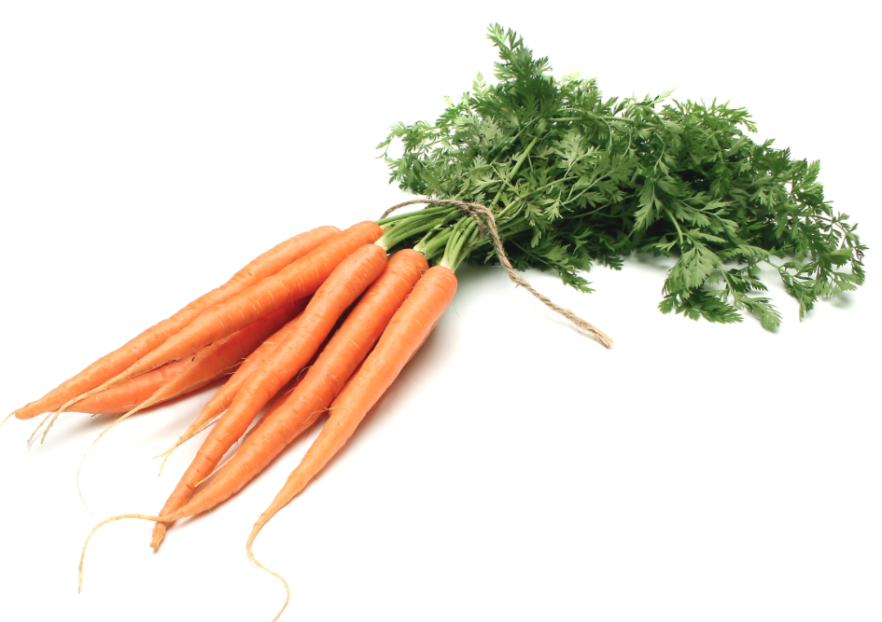
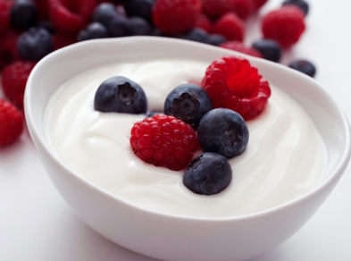
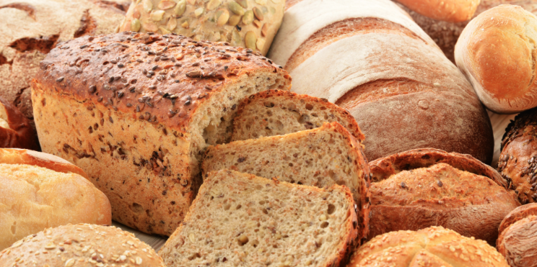
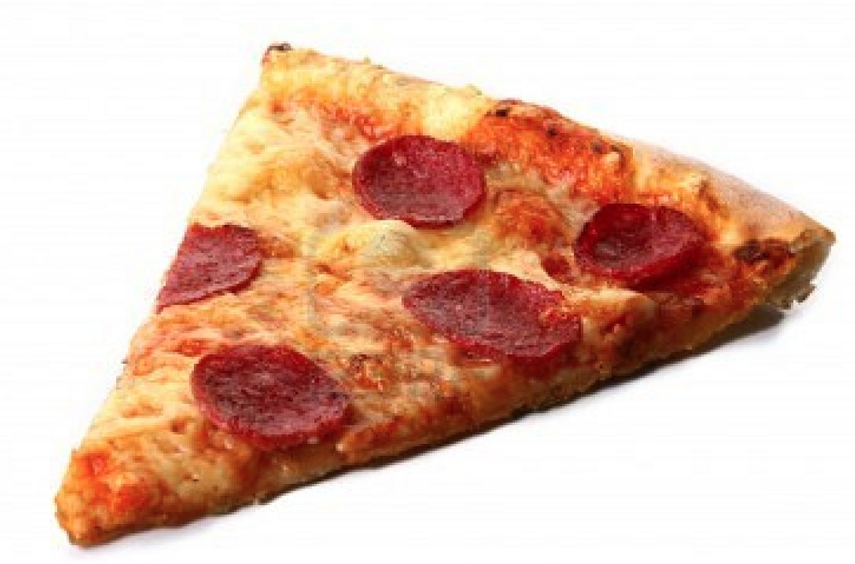
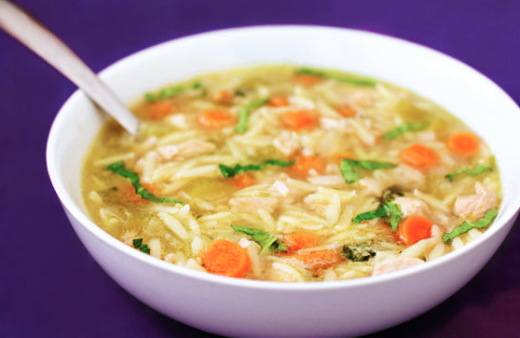
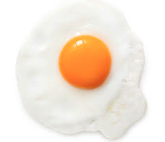
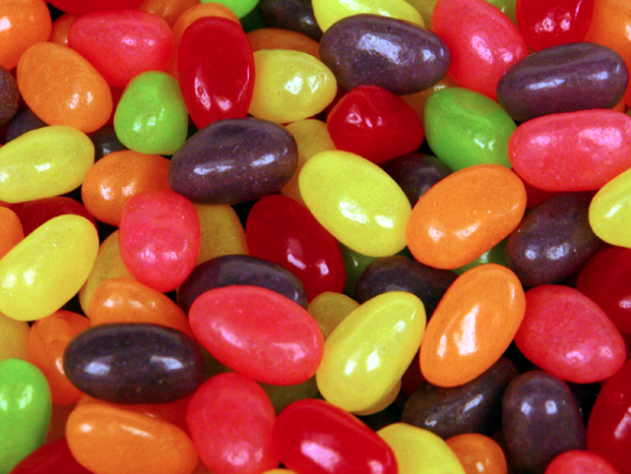
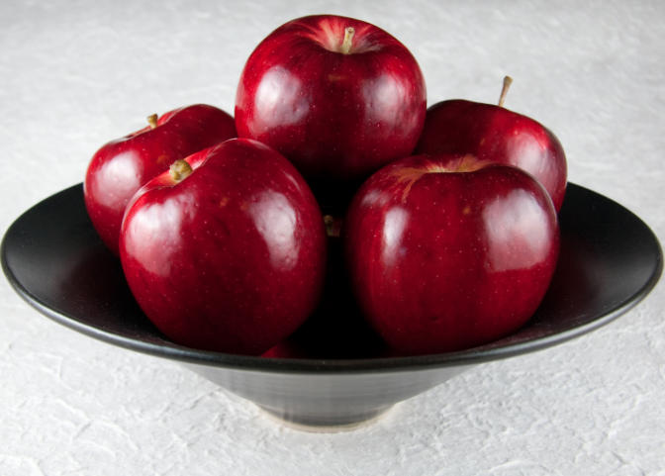
Food Cards
PIZZA
CARROTS
YOGURT
BREAD
SOUP
EGGS
JELLY BEANS
APPLE

Slide 5
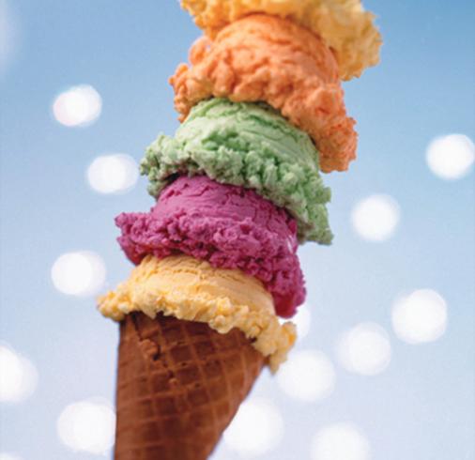
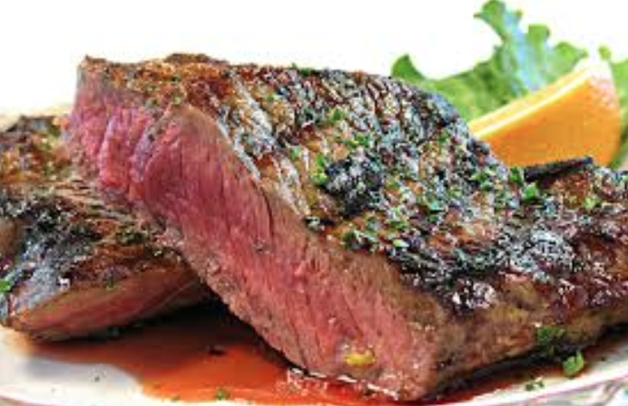
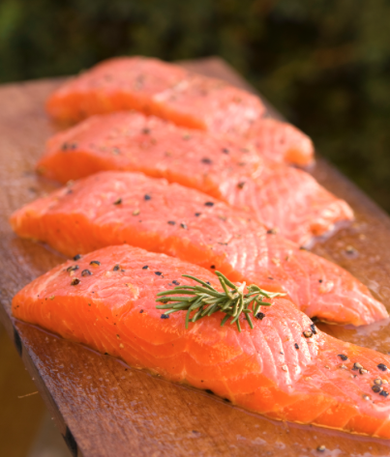
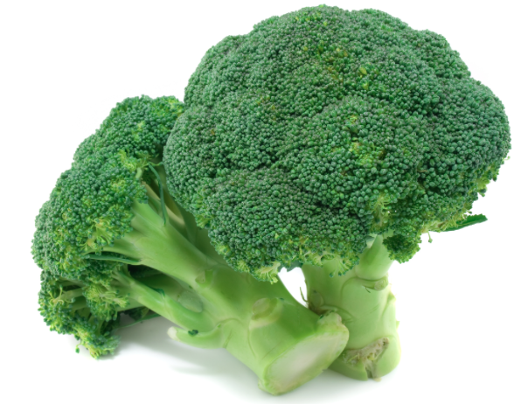
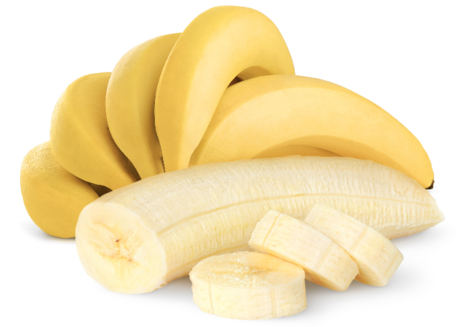
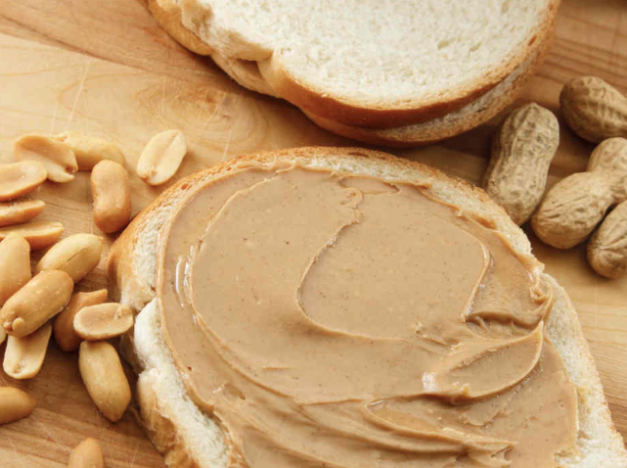
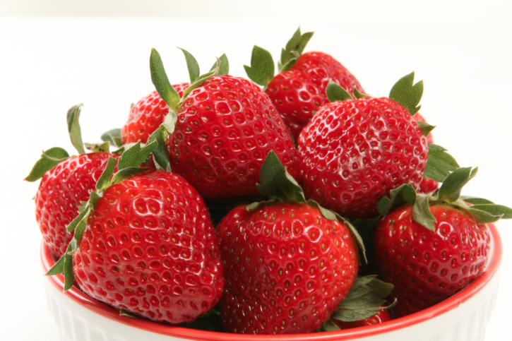
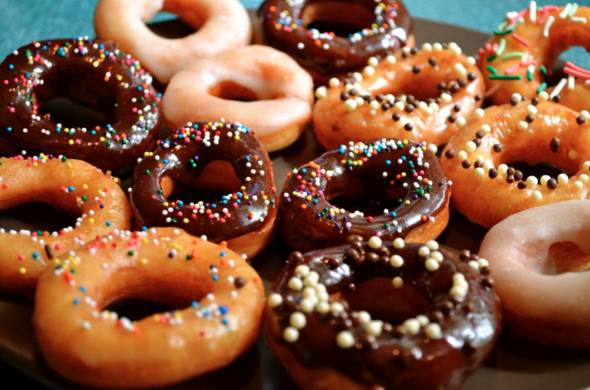
Food Cards (continued)
ICE CREAM
BROCCOLI
STEAK
SALMON
BANANA
PEANUT BUTTER
DOUGHNUT
STRAWBERRIES

Slide 6
Student A, Rank Your Cards!
Most favorite
1
2
3
4
5
6
7
8
9
10
11
12
13
14
15
16
Least Favorite

Slide 7
Student B, Rank Your Cards!
Most favorite
1
2
3
4
5
6
7
8
9
10
11
12
13
14
15
16
Least Favorite

