Slide 1
The PYTimes
Today’s whether: if, elif, or else!
Congrats, Pats!
Homework #0 Due Fri., 2/6
Homework #1 Due Fri., 2/13
1-2) Python challenges
0) Reading/response
3-5) Picobot challenges
6) Reading response
1) Lab: data
2) Lab: data + functions
Composite sketch of one of the attackers drawn from three-eyewitness accounts
3) Putting the fun into functions!
Prof Alienated!?
Alien Attack? Picobot programmer Z. Dodds was subject of a bizarre attack yesterday by three-eyed aliens. The trinocular terrors, it seems, were conducting experiments that would help them understand “how humans think.”
It seems the aliens used a shrinking ray, which let them enter the programmer’s head in order to see what was happening. A witness reports deeply disappointed voices emanating from within.
Automatic translation: if it's possible for human languages... perhaps for CS, too?
see three-eyed alien attack, p. 42

Slide 2
uses a "shell" language
Computer command-line
% cd Desktop
% ls or dir
% python
just about all we'll do…
% python hw1pr1.py
Python command-line
runs the Python language
>>> 6*7
>>> s = 'harvey mudd college'
>>> len(s)
this feels like CS5's primary topic!
>>> s.upper()

Slide 3
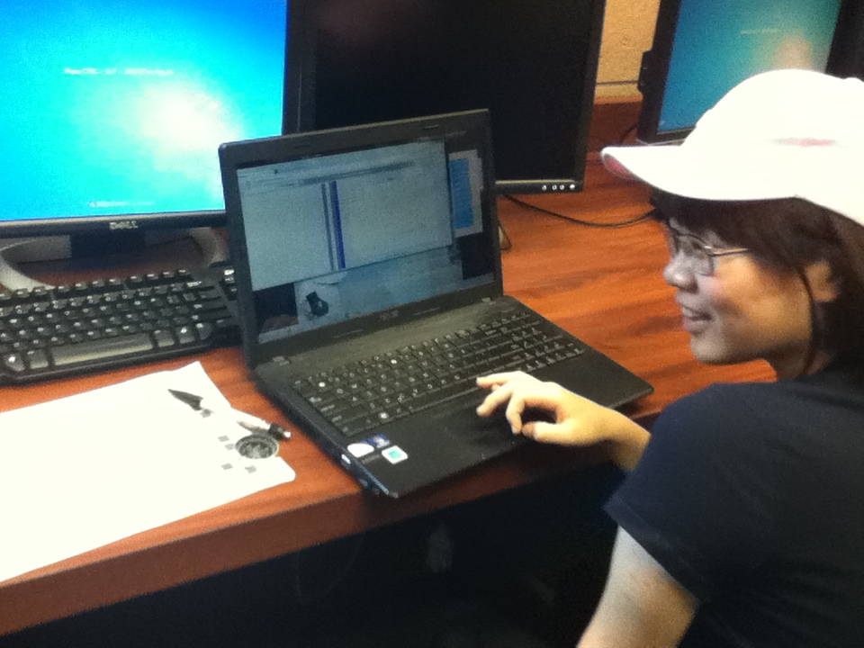
Picobot!?

Slide 4
Jack Ma's Picobot rules…

Slide 5
Data, data everywhere…
Data

Slide 6
Data, data everywhere…
1 Zettabyte
1.8 ZB
8.0 ZB
800 EB
Data produced each year
logarithmic scale
161 EB
1 Exabyte
5 EB
100-years of HD video + audio
1 Petabyte
Human brain's capacity
60 PB
2002
2006
2009
2011
2015
14 PB
1 Petabyte == 1000 TB
1 TB = 1000 GB
References
(2015) 8 ZB: http://www.emc.com/collateral/analyst-reports/idc-extracting-value-from-chaos-ar.pdf
(2002) 5 EB: http://www2.sims.berkeley.edu/research/projects/how-much-info-2003/execsum.htm
(2011) 1.8 ZB: http://www.emc.com/leadership/programs/digital-universe.htm
(life in video) 60 PB: in 4320p resolution, extrapolated from 16MB for 1:21 of 640x480 video (w/sound) – almost certainly a gross overestimate, as sleep can be compressed significantly!
(2009) 800 EB: http://www.emc.com/collateral/analyst-reports/idc-digital-universe-are-you-ready.pdf
(2006) 161 EB: http://www.emc.com/collateral/analyst-reports/expanding-digital-idc-white-paper.pdf
(brain) 14 PB: http://www.quora.com/Neuroscience-1/How-much-data-can-the-human-brain-store

Slide 7
Big Data?
Notes:
Electric: from www.staticfreesoftware.com
My tutorial is at:
http://odin.ac.hmc.edu/~harris/class/chipdesign/electric.pdf
Lasergene (a molecular biology suite of programs for aligning and comparing
DNA sequences, etc.)
Statview (statistical analysis)
KaleidaGraph (plotting & graphing)
Populus (programs that simulate ecological and evolutionary processes)

Slide 8
'debt'
more-than-average searches for debt: sell
fewer-than-average searches for debt: buy
Notes:
Electric: from www.staticfreesoftware.com
My tutorial is at:
http://odin.ac.hmc.edu/~harris/class/chipdesign/electric.pdf
Lasergene (a molecular biology suite of programs for aligning and comparing
DNA sequences, etc.)
Statview (statistical analysis)
KaleidaGraph (plotting & graphing)
Populus (programs that simulate ecological and evolutionary processes)

Slide 9
'fun'
'water'
Notes:
Electric: from www.staticfreesoftware.com
My tutorial is at:
http://odin.ac.hmc.edu/~harris/class/chipdesign/electric.pdf
Lasergene (a molecular biology suite of programs for aligning and comparing
DNA sequences, etc.)
Statview (statistical analysis)
KaleidaGraph (plotting & graphing)
Populus (programs that simulate ecological and evolutionary processes)

Slide 10
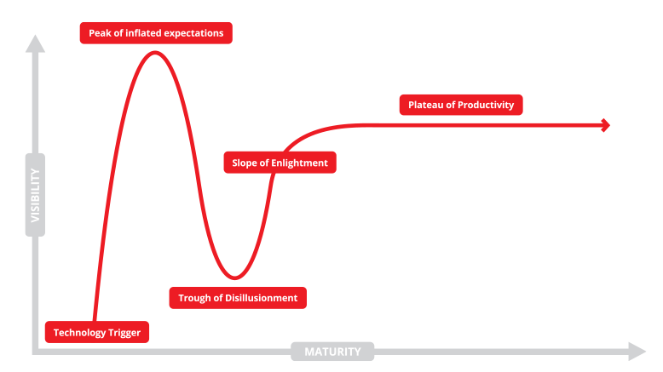
The Technology Hype Cycle…
not quite sure where we are right now…?
If you torture the data enough, it will confess.
- R. Coates, statistician
Notes:
Electric: from www.staticfreesoftware.com
My tutorial is at:
http://odin.ac.hmc.edu/~harris/class/chipdesign/electric.pdf
Lasergene (a molecular biology suite of programs for aligning and comparing
DNA sequences, etc.)
Statview (statistical analysis)
KaleidaGraph (plotting & graphing)
Populus (programs that simulate ecological and evolutionary processes)

Slide 11
Data's elevation?
wisdom
G.G.M, et al.
knowledge
G. Garcia Marquez
Google's users
information
Google
data
Notes:
Electric: from www.staticfreesoftware.com
My tutorial is at:
http://odin.ac.hmc.edu/~harris/class/chipdesign/electric.pdf
Lasergene (a molecular biology suite of programs for aligning and comparing
DNA sequences, etc.)
Statview (statistical analysis)
KaleidaGraph (plotting & graphing)
Populus (programs that simulate ecological and evolutionary processes)

Slide 12
Python's data types
Name
Example
What is it?
float
3.14
values with a fractional part
long
10**100
integers > 2147483647
int
42
integers <= 2147483647
True
the results from a comparison:
bool
False
==, !=, <, >, <=, >=
"Boolean value"
Hey - someone can't spelle !
George Boole
Notes:
Electric: from www.staticfreesoftware.com
My tutorial is at:
http://odin.ac.hmc.edu/~harris/class/chipdesign/electric.pdf
Lasergene (a molecular biology suite of programs for aligning and comparing
DNA sequences, etc.)
Statview (statistical analysis)
KaleidaGraph (plotting & graphing)
Populus (programs that simulate ecological and evolutionary processes)

Slide 13
Datatypes ~ genes…
What will these results be?
Dominant
float
1.0 / 5
long
10**100 - 10**100
int
1 / 5
bool
41 + True
Recessive
Notes:
Electric: from www.staticfreesoftware.com
My tutorial is at:
http://odin.ac.hmc.edu/~harris/class/chipdesign/electric.pdf
Lasergene (a molecular biology suite of programs for aligning and comparing
DNA sequences, etc.)
Statview (statistical analysis)
KaleidaGraph (plotting & graphing)
Populus (programs that simulate ecological and evolutionary processes)

Slide 14
Operate!
higher precedence
( )
**
-
* % /
+ -
> == <
=
Notes:
Electric: from www.staticfreesoftware.com
My tutorial is at:
http://odin.ac.hmc.edu/~harris/class/chipdesign/electric.pdf
Lasergene (a molecular biology suite of programs for aligning and comparing
DNA sequences, etc.)
Statview (statistical analysis)
KaleidaGraph (plotting & graphing)
Populus (programs that simulate ecological and evolutionary processes)

Slide 15
O-per-ate!
higher precedence
( )
**
-
* % /
+ -
> == <
=
Notes:
Electric: from www.staticfreesoftware.com
My tutorial is at:
http://odin.ac.hmc.edu/~harris/class/chipdesign/electric.pdf
Lasergene (a molecular biology suite of programs for aligning and comparing
DNA sequences, etc.)
Statview (statistical analysis)
KaleidaGraph (plotting & graphing)
Populus (programs that simulate ecological and evolutionary processes)

Slide 16
Python operators
higher precedence
( )
parens
**
power
-
negate
* % /
times, mod, divide
add, subtract
+ -
> == <
compare
=
assign
It's not worth remembering all these %+/* things! I’d recommend parentheses over precedence.
Notes:
Electric: from www.staticfreesoftware.com
My tutorial is at:
http://odin.ac.hmc.edu/~harris/class/chipdesign/electric.pdf
Lasergene (a molecular biology suite of programs for aligning and comparing
DNA sequences, etc.)
Statview (statistical analysis)
KaleidaGraph (plotting & graphing)
Populus (programs that simulate ecological and evolutionary processes)

Slide 17
% the mod operator
7 % 3
9 % 3
8 % 3
16 % 7
x%y returns the remainder when x is divided by y
x%2 == 0
x%2 == 1
For what values of x are these True?
x%4 == 0
What happens on these years?
x%4 == 3
Notes:
Electric: from www.staticfreesoftware.com
My tutorial is at:
http://odin.ac.hmc.edu/~harris/class/chipdesign/electric.pdf
Lasergene (a molecular biology suite of programs for aligning and comparing
DNA sequences, etc.)
Statview (statistical analysis)
KaleidaGraph (plotting & graphing)
Populus (programs that simulate ecological and evolutionary processes)

Slide 18
the "equals" operators
= != ==
This is true – but what is it saying!?
Notes:
Electric: from www.staticfreesoftware.com
My tutorial is at:
http://odin.ac.hmc.edu/~harris/class/chipdesign/electric.pdf
Lasergene (a molecular biology suite of programs for aligning and comparing
DNA sequences, etc.)
Statview (statistical analysis)
KaleidaGraph (plotting & graphing)
Populus (programs that simulate ecological and evolutionary processes)

Slide 19
the "equals" operators
= != ==
SET equals
isn't equal to
TEST equals
I want === !
Notes:
Electric: from www.staticfreesoftware.com
My tutorial is at:
http://odin.ac.hmc.edu/~harris/class/chipdesign/electric.pdf
Lasergene (a molecular biology suite of programs for aligning and comparing
DNA sequences, etc.)
Statview (statistical analysis)
KaleidaGraph (plotting & graphing)
Populus (programs that simulate ecological and evolutionary processes)

Slide 20
Try it!
how = works
name or names
x = 41
y = x + 1
z = x + y
Run
these lines
x
y
z
Extra!
What are x, y, and z at this time?
a = 11/2
b = a%3
c = b** a+b *a
Then run this
x = x + y
x
y
z
What are x, y, and z at this time?
What are the values of a, b, and c after these lines run?

Slide 21
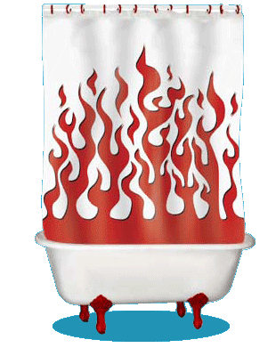
Inside the machine…
x = 41
y = x + 1
What's happening in python:
What is happening behind the scenes:
Computation
Data Storage
41
42
name: x
type: int
LOC: 312
name: y
type: int
LOC: 324
memory location 312
memory location 324
variables ~ boxes
id, del

Slide 22
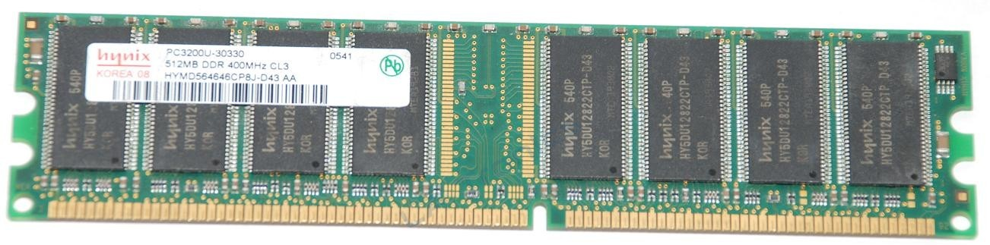
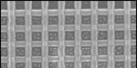
Memory!
Random Access Memory
41
42
83
105
name: x
type: int
LOC: 312
name: y
type: int
LOC: 324
name: z
type: int
LOC: 336
name: a
type: int
LOC: 348
a big list of boxes, each with a name, type, location, and value
512 MB of memory
on or off
bit = 1 "bucket" of charge
Wow! Who knew they make memory out of wicker?
byte = 8 bits

Slide 23
Are numbers enough for everything?
Yes and no…
You need lists of numbers, as well!
and strings - lists of characters - too.
Both of these are Python sequences…

Slide 24
string functions
str(42) returns '42'
converts input to a string
len('42') returns 2
returns the string’s length
'XL' + 'II' returns 'XLII'
concatenates strings
'VI' * 7 returns 'VIVIVIVIVIVIVI'
repeats strings
composing strings using + and *

Slide 25
string functions
str(42) returns '42'
converts input to a string
len('42') returns 2
returns the string’s length
'XL' + 'II' returns 'XLII'
concatenates strings
'VI' * 7 returns 'VIVIVIVIVIVIVI'
repeats strings
s1 = 'ha'
Given these strings
s2 = 't'
s1 + s2
What are
2*s1 + s2 + 2*(s1+s2)
What did you say!?!

Slide 26
Data ~ dig in!
s = 'harvey'
0
1
2
3
4
5
s[2]
'r'
indexing
is
index
s[2:4]
'rv'
is
slicing
s[::-1]
'yevrah'
is
Notes:
Selena's estoy contigo
Spanish was Selena's scond language

Slide 27
Indexing uses [ ]
s = 'harvey mudd college'
0
1
2
3
4
5
6
7
8
9
10
11
12
13
14
15
16
17
18
index
Read as "s-of-zero" or "s-zero"
s[0]
is
s[6]
is
s[ ]
'e'
is
Notes:
Selena's estoy contigo
Spanish was Selena's scond language

Slide 28
Negative indices…
In a negative mood ? Python's there for you !
0
1
2
3
4
5
6
7
8
9
10
11
12
13
14
15
16
17
18
s = 'harvey mudd college'
-19
-17
-15
-13
-11
-9
-7
-5
-3
-1
-18
-16
-14
-12
-10
-8
-6
-4
-2
Negative indices count backwards from the end!
s[-1]
is
s[-2]
is
s[-0]
is
Notes:
Selena's estoy contigo
Spanish was Selena's scond language

Slide 29
Slicing
s = 'harvey mudd college'
0
1
2
3
4
5
6
7
8
9
10
11
12
13
14
15
16
17
18
s[ : ]
slices the string, returning a substring
What's going on here?
s[0:6]
is
'harvey'
s[12:18]
is
'colleg'
s[17:]
is
'ge'
s[:]
is
'harvey mudd college'

Slide 30
Slicing
s = 'harvey mudd college'
0
1
2
3
4
5
6
7
8
9
10
11
12
13
14
15
16
17
18
s[ : ]
slices the string, returning a substring
first index is the first character
second index is ONE AFTER the last character
a missing index means that end of the string
s[0:6]
is
'harvey'
s[12:18]
is
'colleg'
s[17:]
is
'ge'
s[:]
is
'harvey mudd college'

Slide 31
Slicing
s = 'harvey mudd college'
0
1
2
3
4
5
6
7
8
9
10
11
12
13
14
15
16
17
18
s[15:-1]
is
What are these slices?
s[:2]
is
is
'mud'
and these?
is
'e'
Don't wor'e'-
Be hap'e' !

Slide 32
Skip-Slicing
s[ : : ]
the third index is the stride length
default is +1
s = 'harvey mudd college'
0
1
2
3
4
5
6
7
8
9
10
11
12
13
14
15
16
17
18
s[0:8:2]
'hre '
is
s[17:12:-1]
is
is
'doe'
G. Garcia Marquez
s[1::6]
is
I love this one.

Slide 33
Lists ~ collections of any data
L = [ 3.14, [2,40], 'third', 42 ]
Commas separate elements.
Square brackets tell python you want a list.
Notes:
Electric: from www.staticfreesoftware.com
My tutorial is at:
http://odin.ac.hmc.edu/~harris/class/chipdesign/electric.pdf
Lasergene (a molecular biology suite of programs for aligning and comparing
DNA sequences, etc.)
Statview (statistical analysis)
KaleidaGraph (plotting & graphing)
Populus (programs that simulate ecological and evolutionary processes)

Slide 34
Lists ~ collections of any data
L = [ 3.14, [2,40], 'third', 42 ]
len(L)
L[0]
L[0:1]
length
indexing
slicing
could return a different type
always returns the same type, and always returns a substructure!
From L how could you get
'hi'
Notes:
Electric: from www.staticfreesoftware.com
My tutorial is at:
http://odin.ac.hmc.edu/~harris/class/chipdesign/electric.pdf
Lasergene (a molecular biology suite of programs for aligning and comparing
DNA sequences, etc.)
Statview (statistical analysis)
KaleidaGraph (plotting & graphing)
Populus (programs that simulate ecological and evolutionary processes)

Slide 35
pi = [3,1,4,1,5,9]
Try it!
L = [ 'pi', "isn't", [4,2] ]
M = 'You need parentheses for chemistry !'
We ( )
0
4
8
12
16
20
24
28
32
Part 1
Part 2
6
'pi'
What is len(pi)
What is L[0]
These two are different!
3
What is len(L)
What is L[0:1]
What is len(L[1])
'i'
What is L[0][1]
What is pi[2:4]
What slice of M is 'try'? is 'shoe'?
What slice of pi is [3,1,4]
pi[:3]
What is M[9:15]
What slice of pi is [3,4,5]
What is M[::5]
Extra! Mind Muddlers
What are pi[0]*(pi[1] + pi[2]) and pi[0]*(pi[1:2] + pi[2:3]) ?
These two are different, too…
Notes:
Prof. Aaron Laconte; Prof. Katie Purvis-Roberts

Slide 36
pi = [3,1,4,1,5,9]
L = [ 'pi', "isn't", [4,2] ]
M = 'You need parentheses for chemistry !'
We ( )
0
4
8
12
16
20
24
28
32
Part 1
Part 2
6
'pi'
What is len(pi)
What is L[0]
element
3
['pi']
sublist
What is len(L)
What is L[0:1]
What is len(L[1])
What is L[0][1]
[4,1]
What is pi[2:4]
What slice of M is 'try'? is 'shoe'?
M[31:34]
What slice of pi is [3,1,4]
pi[:3]
'parent'
What is M[9:15]
What slice of pi is [3,4,5]
pi[::2]
What is M[::5]
Extra! Mind Muddlers
What are pi[0]*(pi[1] + pi[2]) and pi[0]*(pi[1:2] + pi[2:3]) ?
15
[1,4,1,4,1,4]

Slide 37
pi = [3,1,4,1,5,9]
L = [ 'pi', "isn't", [4,2] ]
M = 'You need parentheses for chemistry !'
We ( )
0
4
8
12
16
20
24
28
32
Part 1
Part 2
6
'pi'
What is len(pi)
What is L[0]
element
3
['pi']
sublist
What is len(L)
What is L[0:1]
5
'i'
What is len(L[1])
What is L[0][1]
[4,1]
What is pi[2:4]
What slice of M is 'try'? is 'shoe'?
M[31:34]
M[30:16:-4]
What slice of pi is [3,1,4]
pi[:3]
'parent'
What is M[9:15]
What slice of pi is [3,4,5]
pi[::2]
'Yeah cs!'
What is M[::5]
Extra! Mind Muddlers
What are pi[0]*(pi[1] + pi[2]) and pi[0]*(pi[1:2] + pi[2:3]) ?
15
[1,4,1,4,1,4]

Slide 38
Python slices - it dices...
( data, at least )
… but wait, there's more!

Slide 39
Functioning in Python
# my own function!
def dbl( x ):
""" returns double its input, x """
return 2x
This doesn't look quite right…

Slide 40
Functioning in Python
comment for other coders
# my own function!
def dbl( x ):
""" returns double its input, x """
return 2*x
documentation string for all users
Python's keywords
Some of Python's baggage…

Slide 41
Functioning in Python
def undo(s):
""" this "undoes" its input, s """
return 'de' + s
>>> undo('caf')
'decaf'
>>> undo(undo('caf'))
strings, lists, numbers … all data are fair game

Slide 42
Computation's Dual Identity
Computation
Data Storage
41
42
name: x
type: int
LOC: 300
name: y
type: int
LOC: 304
memory location 300
memory location 304
variables ~ boxes
Last time
But what does all this stuff look like ?

Slide 43
Functioning across disciplines
procedure
structure
def g(x):
return x**100
g(x) = x¹⁰⁰
CS's googolizer
Math's googolizer
defined by what it does
defined by what it is
+ how efficiently it works
Notes:
my foreign language teachers always tried to convince me that the skill of speaking, reading and writing a foreign language…
I didn’t believe them then and I don’t believe them now -- but I do believe that reading and writing a computer language is the way to get a strong intuitive understanding of how machines think -- it’s also important for getting them to do what you want them to, but even if you forget everything this course (hopefully) teaches about Java (compiler, datatypes, Classes and Objects), the real goal is that you take away a deeper insight into how machines think
familiar and sometimes not so familiar… deceptively easy
you mean I have to type all that!!

Slide 44
Giving names to data
def flipside(s):
""" flipside(s): swaps s's sides!
input s: a string
"""
x = len(s)/2
return s[x:] + s[:x]
This idea is the key to your happiness!
Notes:
show help!

Slide 45
Use variables!
Hey - I'm happy about this, too!
def flipside(s):
x = len(s)/2
return s[x:] + s[:x]
def flipside(s):
return s[len(s)/2:] + s[:len(s)/2]
Avoid this approach…
Why would computers "prefer" the top version, too?
Notes:
show help!

Slide 46
Challenge
How functions work…
-4
What is demo(-4) ?
def demo(x):
return x + f(x)
def f(x):
return 11*g(x) + g(x/2)
def g(x):
return -1 * x
I might have a guess…
Notes:
vault 713?

Slide 47
How functions work…
def demo(x):
return x + f(x)
demo
stack frame
x = -4
return -4 + f(-4)
def f(x):
return 11*g(x) + g(x/2)
def g(x):
return -1 * x
Hey! This must be a stack-frame frame!
>>> demo(-4) ?
Notes:
vault 713?

Slide 48
How functions work…
def demo(x):
return x + f(x)
demo
stack frame
x = -4
return -4 + f(-4)
def f(x):
return 11*g(x) + g(x/2)
f
stack frame
def g(x):
return -1 * x
x = -4
return 11*g(x) + g(x/2)
>>> demo(-4) ?
Notes:
vault 713?

Slide 49
How functions work…
def demo(x):
return x + f(x)
demo
stack frame
x = -4
return -4 + f(-4)
def f(x):
return 11*g(x) + g(x/2)
f
stack frame
def g(x):
return -1 * x
x = -4
return 11*g(x) + g(x/2)
These are distinct memory locations both holding x's.
>>> demo(-4) ?
Notes:
vault 713?

Slide 50
How functions work…
def demo(x):
return x + f(x)
demo
stack frame
x = -4
return -4 + f(-4)
def f(x):
return 11*g(x) + g(x/2)
f
stack frame
def g(x):
return -1 * x
x = -4
return 11*g(-4) + g(-4/2)
g
stack frame
x = -4
>>> demo(-4) ?
return -1.0 * x
Notes:
vault 713?

Slide 51
How functions work…
def demo(x):
return x + f(x)
demo
stack frame
x = -4
return -4 + f(-4)
def f(x):
return 11*g(x) + g(x/2)
f
stack frame
def g(x):
return -1 * x
x = -4
return 11* 4 + g(-4/2)
g
done!
x = -4
>>> demo(-4) ?
return -1 * -4
4
Notes:
vault 713?

Slide 52
How functions work…
def demo(x):
return x + f(x)
demo
stack frame
x = -4
return -4 + f(-4)
def f(x):
return 11*g(x) + g(x/2)
f
stack frame
def g(x):
return -1 * x
x = -4
return 11* 4 + g(-4/2)
>>> demo(-4) ?
the "return value"
Notes:
vault 713?

Slide 53
How functions work…
def demo(x):
return x + f(x)
demo
stack frame
x = -4
return -4 + f(-4)
def f(x):
return 11*g(x) + g(x/2)
f
stack frame
def g(x):
return -1 * x
x = -4
return 11* 4 + g(-4/2)
g
x = -2
>>> demo(-4) ?
return -1 * -2
2
These are distinct memory locations both holding x's – and now they also have different values!!
Notes:
vault 713?

Slide 54
How functions work…
def demo(x):
return x + f(x)
demo
stack frame
x = -4
return -4 + f(-4)
def f(x):
return 11*g(x) + g(x/2)
f
stack frame
def g(x):
return -1 * x
x = -4
return 11* 4 + 2
>>> demo(-4) ?
the "return value"
Notes:
vault 713?

Slide 55
How functions work…
def demo(x):
return x + f(x)
demo
stack frame
x = -4
return -4 + f(-4)
def f(x):
return 11*g(x) + g(x/2)
f
def g(x):
return -1 * x
x = -4
return 11* 4 + 2
46
>>> demo(-4) ?
Notes:
vault 713?

Slide 56
How functions work…
def demo(x):
return x + f(x)
demo
stack frame
x = -4
return -4 + 46
def f(x):
return 11*g(x) + g(x/2)
def g(x):
return -1 * x
>>> demo(-4)
42
42
Notes:
vault 713?

Slide 57
Douglas Adams's 42
Those zero-eyed aliens are a bit much…
answer: 42 question: unknown
Notes:
ZACH
show python in console

Slide 58
Function stacking
def demo(x):
return x + f(x)
demo
stack frame
x = -4
return -4 + f(-4)
the stack
def f(x):
return 11*g(x) + g(x/2)
f
def g(x):
return -1 * x
x = -4
return 11* 4 + g(-4/2)
"The stack"
g
x = -2
is a memory area that
return -1 * -2
2
(1) keeps separate variables for each function call…
(2) remembers where to send results back to…
Notes:
vault 713?

Slide 59
return > print
def dbl(x):
""" dbls x? """
return 2*x
def dblPR(x):
""" dbls x? """
print 2*x
>>> ans = dbl(21)
>>> ans = dblPR(21)

Slide 60
return > print
def dbl(x):
""" dbls x? """
return 2*x
def dblPR(x):
""" dbls x? """
print 2*x
>>> ans = dbl(21)
>>> ans = dblPR(21)
print just prints stuff to the screen...
… which the shell then prints!
return yields the function call's value …

Slide 61
Challenge!
What eight lines does myst(3) print?
3
def myst(x):
""" _myst_ery fun' """
print "x is", x
if x <= 1:
print "Done! Returning 1"
return 1
else:
print "Calling myst(", x-1, ")"
old_result = myst( x-1 )
new_result = x * old_result
print "Returning", new_result
return new_result
Notes:
vault 713?

Slide 62
Challenge!
What eight lines does myst(3) print?
3
x is 3
def myst(x):
""" _myst_ery fun' """
print "x is", x
if x <= 1:
print "Done! Returning 1"
return 1
else:
print "Calling myst(", x-1, ")"
old_result = myst( x-1 )
new_result = x * old_result
print "Returning", new_result
return new_result
Calling myst( 2 )
x is 2
Calling myst( 1 )
x is 1
Done! Returning 1
Returning 2
Returning 6
… returns 6
Notes:
vault 713?

Slide 63
Function design
Notes:
vault 713?

Slide 64
Thinking sequentially
factorial
5 ! = 120
5 ! = 5 * 4 * 3 * 2 * 1
N ! = N * (N-1) * (N-2) * … * 3 * 2 * 1

Slide 65
Thinking sequentially
factorial
5 ! = 120
bit later (March and beyond)
5 ! = 5 * 4 * 3 * 2 * 1
N ! = N * (N-1) * (N-2) * … * 3 * 2 * 1

Slide 66
Thinking recursively
factorial
Recursion == self-reference!
5 ! = 120
5 ! = 5 * 4 * 3 * 2 * 1
5 ! =
N ! = N * (N-1) * (N-2) * … * 3 * 2 * 1
N ! =

Slide 67
Warning: this is legal!
def fac(N):
return N * fac(N-1)
I wonder how this code will STACK up!?
Notes:
Was that Gandalf or Dumbledore that "fell forever" ?

Slide 68
legal != recommended
def fac(N):
return N * fac(N-1)
The calls to fac will never stop: there's no BASE CASE!
Make sure you have a base case, then worry about the recursion...

Slide 69
Thinking recursively
def fac(N):
if N <= 1:
return 1
Base case
"How could I use the factorial of anything smaller than N?" Then do!
Ask yourself:

Slide 70
Thinking recursively
def fac(N):
if N <= 1:
return 1
else:
return N*fac(N-1)
Base case
Recursive case (shorter)
Human: Base case and 1 step
Computer: Everything else

Slide 71
Thinking recursively
def fac(N):
if N <= 1:
return 1
else:
rest = fac(N-1)
return rest * N
Base case
Recursive case
(clearer, for some)
Human: Base case and 1 step
Computer: Everything else

Slide 72
def fac(N):
if N <= 1:
return 1
else:
return N * fac(N-1)
Behind the curtain…
fac(5)

Slide 73
def fac(N):
if N <= 1:
return 1
else:
return N * fac(N-1)
Behind the curtain…
fac(5)
5 * fac(4)

Slide 74
def fac(N):
if N <= 1:
return 1
else:
return N * fac(N-1)
Behind the curtain…
fac(5)
5 * fac(4)
4 * fac(3)
5 *
Operation waiting …

Slide 75
def fac(N):
if N <= 1:
return 1
else:
return N * fac(N-1)
Behind the curtain…
fac(5)
5 * fac(4)
4 * fac(3)
5 *
5 * 4 *
3 * fac(2)
More operations waiting…

Slide 76
def fac(N):
if N <= 1:
return 1
else:
return N * fac(N-1)
Behind the curtain…
fac(5)
5 * fac(4)
4 * fac(3)
5 *
5 * 4 *
3 * fac(2)
5 * 4 * 3 *
2 * fac(1)

Slide 77
def fac(N):
if N <= 1:
return 1
else:
return N * fac(N-1)
Behind the curtain…
fac(5)
N=5
"The Stack"
5 * fac(4)
N=4
4 * fac(3)
5 *
N=3
5 * 4 *
3 * fac(2)
N=2
Stack frames hold all of the individual calls to fac
5 * 4 * 3 *
2 * fac(1)
N=1
5 different N's are living in memory…
5 * 4 * 3 * 2 *
1

Slide 78
def fac(N):
if N <= 1:
return 1
else:
return N * fac(N-1)
Behind the curtain…
fac(5)
5 * fac(4)
4 * fac(3)
5 *
5 * 4 *
3 * fac(2)
5 * 4 * 3 *
2 * 1

Slide 79
def fac(N):
if N <= 1:
return 1
else:
return N * fac(N-1)
Behind the curtain…
fac(5)
5 * fac(4)
4 * fac(3)
5 *
5 * 4 *
3 * 2

Slide 80
def fac(N):
if N <= 1:
return 1
else:
return N * fac(N-1)
Behind the curtain…
fac(5)
5 * fac(4)
4 * 6
5 *

Slide 81
def fac(N):
if N <= 1:
return 1
else:
return N * fac(N-1)
Behind the curtain…
fac(5)
5 * 24

Slide 82
def fac(N):
if N <= 1:
return 1
else:
return N * fac(N-1)
Behind the curtain…
fac(5)
Result: 120
show facWPR …
0 x*** -> N 0
0 N*** -> X 1
Recursive step
Look familiar?
Base case

Slide 83
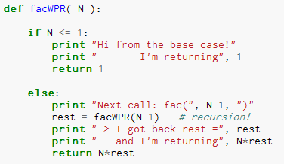
Thinking recursively…
What will print when facWPR(5) is called?

Slide 84
Let recursion do the work for you.
Exploit self-similarity
Less work !
Produce short, elegant code
You handle the base case – the easiest case!
def fac(N):
if N <= 1:
return 1
else:
rest = fac(N-1)
return rest * N
Recursion does almost all of the rest of the problem!
You specify one step at the end

Slide 85
But you do need to do one step yourself…
def fac(N):
if N <= 1:
return 1
else:
return fac(N)
This will not work !

Slide 86
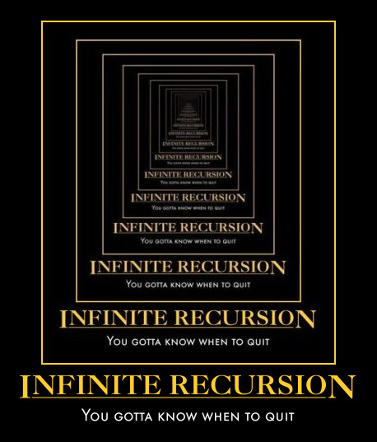
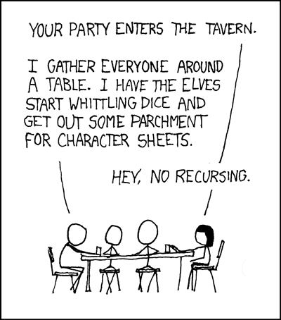
Recursion's advantage:
It handles arbitrary structural depth – all at once!
As a hat, I'm recursive, too!
Notes:
I don’t know if this really works...

Slide 87
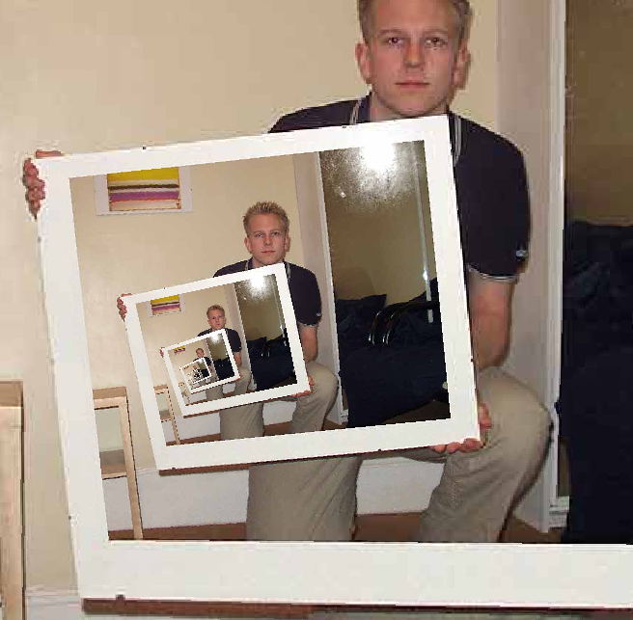
The dizzying dangers of having no base case!
Notes:
I don’t know if this really works...

Slide 88
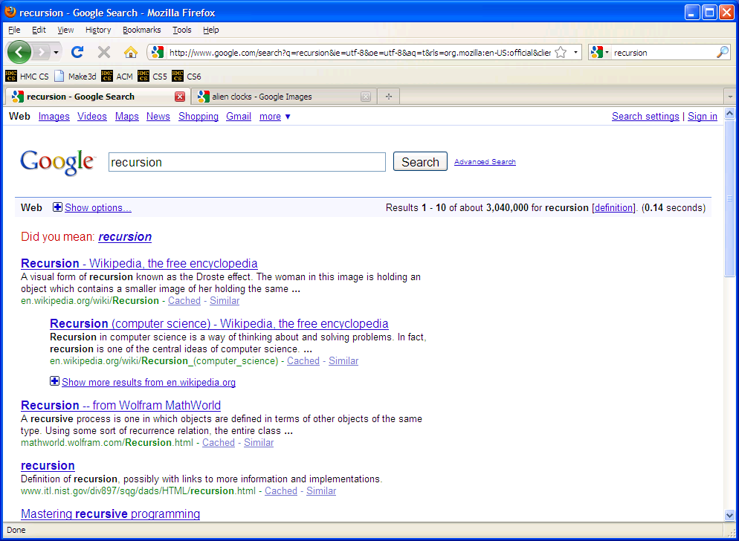

Slide 89
Recursive design…
fun! easy!?
(1) Program the base case.
(2) Find the self-similarity.
cool!
(3) Do one step!
indexing and slicing
(4) Delegate the rest to recursion…
Aha!

Slide 90
One step?
…is easy to do with Python
s = 'aliens'
s[0]
How do we get at the initial character of s?
How do we get at ALL THE REST of s?
s[ ]
'liens'
L = [ 42, 21 ]
L[0]
How do we get at the initial element of L?
L[ ]
How do we get at ALL THE REST of L?
[ 21 ]

Slide 91
def mylen(s):
Picture it!
""" returns the number of
characters in s
input: s, a string
"""
NOT a space – this is no characters at all. This is the empty string – and it has length of 0!
s = ''
mylen('') 0
starts with a vowel – count that vowel and delegate the rest to recursion
s = 'hi'
mylen('hi') 1+mylen( )
wow!
s = 'recursion'
mylen('recursion') 1+mylen( )

Slide 92
def mylen(s):
Picture it!
""" returns the number of
characters in s
input: s, a string
"""
NOT a space – this is no characters at all. This is the empty string – and it has length of 0!
Base case test
s = ''
p == 0
if :
mylen('') 0
return
Base case
starts with a vowel – count that vowel and delegate the rest to recursion
s = 'hi'
mylen('hi') 1+mylen( )
else:
return
wow!
Recursive case
s = 'recursion'
mylen('recursion') 1+mylen( )
Try it!

Slide 93
… complete !
def mylen(s):
""" input: any string, s
output: the number of characters in s
"""
if s == '':
return 0
else:
return 1 + mylen(s[1:])
There's not much len left here!

Slide 94
def mylen(s):
if s == '':
return 0
else:
return 1 + mylen(s[1:])
Behind the curtain:
how recursion works...
mylen('cs5')
1 + mylen('s5')
1 + 1 + mylen('5')
1 + 1 + 1 + mylen('')
1 + 1 + 1 + 0

Slide 95
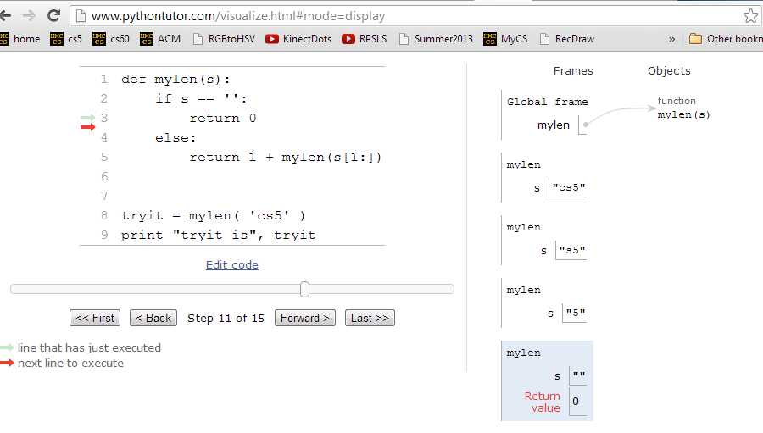
Visualizing…
http://www.pythontutor.com/visualize.html

Slide 96
Picture it!
def mymax(L):
""" returns the max of a nonempty
list of elements, L
"""
one-element list is the smallest list that HAS a max
L = [42]
mymax([42]) 42
first element is less than the second element!
L = [1,4,42]
mymax([1,4,42]) mymax( )
first element is bigger than the second element!
L = [4,1,3,42,7]
mymax([4,1,3,42,7]) mymax( )

Slide 97
Picture it!
def mymax(L):
""" returns the max of a nonempty
list of elements, L
"""
one-element list is the smallest list that HAS a max
Base case test
if len(L) == 1:
L = [42]
return
mymax([42]) 42
Base case
elif :
test of first vs. second elements
first element is less than the second element!
L = [1,4,42]
return
mymax([1,4,42]) mymax([4,42])
Recursive case #1
else:
first element is bigger than the second element!
return
L = [4,1,3,42,7]
Recursive case #1
Try it!
mymax([4,1,3,42,7]) mymax([4,3,42,7])

Slide 98
def mymax(L):
if len(L) == 1:
return L[0]
elif L[0] < L[1]:
return mymax( L[1:] )
else:
return mymax( L[0:1]+L[2:] )
base case
drop 1st
drop 2nd
mymax( [1,4,3,42,-100,7] )
mymax( [4,3,42,-100,7] )
mymax( [4,42,-100,7] )
mymax( [42,-100,7] )
mymax( [42,7] )
mymax( [42] )
42

Slide 99
def power(b,p):
Picture it!
""" returns b to the p power
Use recursion, not **
Inputs: int b, int p:
the base and the power
"""
0
2
==
1
power(2,0) -> 1
5
4
2
==
2*
2
4
power(2,5) -> 2*2
Do you see the call to power!?
p
2
==
2*
2
What should this be?
power(2,p) -> 2*power(…,…)
power(b,p) ->

Slide 100
def power(b,p):
Picture it!
""" returns b to the p power
Use recursion, not **
Inputs: int b, int p:
the base and the power
"""
0
2
==
1
Base case test
p == 0
power(2,0) -> 1
if :
return
Base case
5
4
2
==
2*
2
4
power(2,5) -> 2*2
Do you see the call to power!?
else:
p
2
==
2*
2
return
What should this be?
Recursive case
power(2,p) -> 2*power(…,…)
power(b,p) ->
Want more power?
Try it!
Handle negative p values w/elif.
E.g., power(5,-1) == 0.2

Slide 101
power( 2, 5 )
2* power( 2, 4 )
2* 2* power( 2, 3 )
2* 2* 2* power( 2, 2 )
2* 2* 2* 2* power( 2, 1 )
2* 2* 2* 2* 2* power( 2, 0 )
2* 2* 2* 2* 2* 1
32

Slide 102
Picture it!
def sajak(s):
""" returns the number of vowels
in the input string, s
"""
NOT a space – this is no characters at all. This is the empty string – and it has 0 vowels!
''
sajak('') 0
starts with a vowel – count that vowel and delegate the rest to recursion
'okay'
sajak('okay') 1+sajak( )
starts with a consonant – so skip it and delegate the rest!
'what'
sajak('what') 0+sajak( )

Slide 103
Picture it!
def sajak(s):
""" returns the number of vowels
in the input string, s
"""
NOT a space – this is no characters at all. This is the empty string – and it has 0 vowels!
Base case test
''
if s == '':
sajak('') 0
return
starts with a vowel – count that vowel and delegate the rest to recursion
'okay'
elif
sajak('okay') 1+sajak( )
return
starts with a consonant – so skip it and delegate the rest!
else:
'what'
return
sajak('what') 0+sajak( )
Want more Pat?
Try it!
What 7-letter English word w maximizes sajak(w) ?

Slide 104
sajak( 'eerier' )
1+ sajak( 'erier' )
1+ 1+ sajak( 'rier' )
1+ 1+ 0+ sajak( 'ier' )
1+ 1+ 0+ 1+ sajak( 'er' )
1+ 1+ 0+ 1+ 1+ sajak( 'r' )
1+ 1+ 0+ 1+ 1+ 0+ sajak( '' )
1+ 1+ 0+ 1+ 1+ 0+ 0
4

Slide 105
def power(b,p):
""" inputs: base b and power p (an int)
implements: b**p
"""
if p == 0:
return 1.0
elif p < 0:
return ____________________
else:
return b * power(b,p-1)
Recursion is power!

Slide 106
# of vowels in s
sajak(s):
D
E
S
I
G
N
When there are no letters, there are ZERO vowels
Base case?
Rec. step?
Look at the initial character.
if s[0] is NOT a vowel, the answer is
sajak( s[1:] )
if s[0] is a vowel, the answer is
1 + sajak( s[1:] )

Slide 107
def sajak(s):
if s == '':
return 0
elif s[0]=='a' or s[0]=='e' or…
Is s[0] a vowel?
but how to check for vowels?

Slide 108
Python is… in
I guess Python's the in thing
>>> 'i' in 'team'
False
>>> 'cs' in 'physics'
True
>>> 'i' in 'alien'
True
>>> 3*'i' in 'alien'
False
>>> 42 in [41,42,43]
True
>>> 42 in [[42], '42']
False

Slide 109
let's input 'eerier' for s
def sajak(s):
if len(s) == 0:
return 0
elif s[0] in 'aeiou':
return 1 + sajak(s[1:])
else:
return 0 + sajak(s[1:])
Base Case
if s[0] IS a vowel, the answer is
1 + the # of vowels in the rest of s
Recursive Cases
if s[0] is NOT a vowel, the answer is just
the number of vowels in the rest of s

Slide 110
The key to understanding recursion is, first, to understand recursion.
- a former CS 5 student
It's the eeriest!
Good luck with Homework #1
tutors @ LAC all week!

Slide 112
def power(b,p):
Picture it!
""" returns b to the p power
Use recursion, not **
Inputs: int b, int p:
the base and the power
"""
0
2
==
1
Base case test
p == 0
if :
power(2,0) -> 1
return
Base case
5
4
2
==
2*
2
4
power(2,5) -> 2*2
Do you see the call to power!?
else:
return
p
Recursive case
2
==
2*
2
power(2,p) -> 2*power(…)
Try it!
Want more power?
Handle negative values of p in an elif.
For example, power(5,-1) == 0.2

Slide 113
power(2,5) == 32.0
Try it!
sajak('wheel of fortune') == 6
What about y? You decide…
in general:
def power(b,p):
def sajak(s):
""" returns b to the p power
Use recursion, not **
Inputs: int b, int p:
the base and the power
"""
""" returns the number of vowels
in the input string, s
"""
if s == '':
Base case test
p == 0
if :
Base case test
return
return
elif
elif
return
else:
else:
return
return
Want more power?
Handle negative values of p in an elif.
Want more Pat?
What 7-letter English word w maximizes sajak(w) ?
For example, power(5,-1) == 0.2

Slide 114
def mylen(s):
Picture it!
""" returns the number of
characters in s
input: s, a string
"""
NOT a space – this is no characters at all. This is the empty string – and it has length of 0!
Base case test
s = ''
p == 0
if :
mylen('') 0
return
Base case
starts with a vowel – count that vowel and delegate the rest to recursion
s = 'hi'
mylen('hi') 1+mylen( )
else:
return
wow!
Recursive case
s = 'recursion'
mylen('recursion') 1+mylen( )

Slide 115
Design #2
[1,4,3,42,-100,7]
def mymax(L):
""" input: a NONEMPTY list, L
output: L's maximum element
"""
if :
elif :
len(L)==1
base case test!
return
another case…
return
else:
return

Slide 116
Design #2
def mymax(L):
""" input: a NONEMPTY list, L
output: L's maximum element
"""
if len(L) == 1:
return L[0]
elif L[0] < L[1]:
return mymax( L[1:] )
else:
return mymax( L[0:1] + L[2:] )
Hey - do I get a slice?!

Slide 117
Computation's Dual Identity
Computation
Data Storage
41
42
name: x
type: int
LOC: 300
name: y
type: int
LOC: 304
memory location 300
memory location 304
variables ~ boxes
Last time
But what does all this stuff look like ?

Slide 118
Giving names to data
def flipside(s):
""" flipside(s): swaps s's sides!
input s: a string
"""
x = len(s)/2
return s[x:] + s[:x]
This idea is the key to your happiness!
Notes:
show help!

Slide 119
Use variables!
Hey - I'm happy about this, too!
def flipside(s):
x = len(s)/2
return s[x:] + s[:x]
def flipside(s):
return s[len(s)/2:] + s[:len(s)/2]
Avoid this approach…
Why would computers "prefer" the top version, too?
Notes:
show help!

Slide 120
Test!
(1) function definition
def flipside(s):
""" flipside(s): swaps s's sides!
input s: a string
"""
x = len(s)/2
return s[x:] + s[:x]
#
# Tests!
#
print "flipside('carpets') ~", flipside('carpets')
print "flipside('carpets') ~", flipside('carpets')
print "flipside('carpets') ~", flipside('carpets')
print "flipside('carpets') ~", flipside('carpets')
print "flipside('carpets') ~", flipside('carpets')
(2) function tests
but don't test like this!
We provide these tests (for now…)
control-b in Sublime
Notes:
show help!

Slide 121
This program uses variables constantly!
Using variables…
def convertFromSeconds(s): # total seconds
""" convertFromSeconds(s): Converts an
integer # of seconds into a list of
[days, hours, minutes, seconds]
input s: an int
"""
seconds = s % 60 # leftover seconds
m = s / 60 # total minutes
minutes = m % 60 # leftover minutes
h = m / 60 # total hours
hours = h % 24 # leftover hours
days = h / 24 # total days
return [days, hours, minutes, seconds]
Notes:
show help!

Slide 122
How functions look…
input(s)
name
def convertFromSeconds(s): # total seconds
""" convertFromSectons(s): Converts an
integer # of seconds into a list of
[days, hours, minutes, seconds]
input s: an int
"""
seconds = s % 60 # leftover seconds
m = (s / 60) # total minutes
minutes = m % 60 # leftover minutes
h = m / 60 # total hours
hours = h % 24 # leftover hours
days = h / 24 # total days
return [days, hours, minutes, seconds]
docstring
comments –these are mostly optional in CS 5
code block
return statement
Notes:
show help!

Slide 123
Computation's Dual Identity
accessed through functions…
Computation
Data Storage
41
42
name: x
type: int
LOC: 300
name: y
type: int
LOC: 304
Functions!
memory location 300
memory location 304
variables ~ boxes
It's no coincidence this starts with fun!

Slide 124
Functioning across disciplines
procedure
structure
def g(x):
return x**100
g(x) = x¹⁰⁰
CS's googolizer
Math's googolizer
defined by what it does
defined by what it is
+ how efficiently it works
Notes:
my foreign language teachers always tried to convince me that the skill of speaking, reading and writing a foreign language…
I didn’t believe them then and I don’t believe them now -- but I do believe that reading and writing a computer language is the way to get a strong intuitive understanding of how machines think -- it’s also important for getting them to do what you want them to, but even if you forget everything this course (hopefully) teaches about Java (compiler, datatypes, Classes and Objects), the real goal is that you take away a deeper insight into how machines think
familiar and sometimes not so familiar… deceptively easy
you mean I have to type all that!!

Slide 125
Quiz
First and last name(s):
-4
What is demo(-4) ?
def demo(x):
return x + f(x)
def f(x):
return 11*g(x) + g(x/2)
def g(x):
return -1 * x
I might have a guess…
How functions work…
Notes:
vault 713?

Slide 126
How functions work…
def demo(x):
return x + f(x)
demo
stack frame
x = -4
return -4 + f(-4)
def f(x):
return 11*g(x) + g(x/2)
def g(x):
return -1 * x
Hey! This must be a stack-frame frame!
>>> demo(-4) ?
Notes:
vault 713?

Slide 127
How functions work…
def demo(x):
return x + f(x)
demo
stack frame
x = -4
return -4 + f(-4)
def f(x):
return 11*g(x) + g(x/2)
f
stack frame
def g(x):
return -1 * x
x = -4
return 11*g(x) + g(x/2)
>>> demo(-4) ?
Notes:
vault 713?

Slide 128
How functions work…
def demo(x):
return x + f(x)
demo
stack frame
x = -4
return -4 + f(-4)
def f(x):
return 11*g(x) + g(x/2)
f
stack frame
def g(x):
return -1 * x
x = -4
return 11*g(x) + g(x/2)
These are distinct memory locations both holding x's.
>>> demo(-4) ?
Notes:
vault 713?

Slide 129
How functions work…
def demo(x):
return x + f(x)
demo
stack frame
x = -4
return -4 + f(-4)
def f(x):
return 11*g(x) + g(x/2)
f
stack frame
def g(x):
return -1 * x
x = -4
return 11*g(-4) + g(-4/2)
g
stack frame
x = -4
>>> demo(-4) ?
return -1.0 * x
Notes:
vault 713?

Slide 130
How functions work…
def demo(x):
return x + f(x)
demo
stack frame
x = -4
return -4 + f(-4)
def f(x):
return 11*g(x) + g(x/2)
f
stack frame
def g(x):
return -1 * x
x = -4
return 11* 4 + g(-4/2)
g
done!
x = -4
>>> demo(-4) ?
return -1 * -4
4
Notes:
vault 713?

Slide 131
How functions work…
def demo(x):
return x + f(x)
demo
stack frame
x = -4
return -4 + f(-4)
def f(x):
return 11*g(x) + g(x/2)
f
stack frame
def g(x):
return -1 * x
x = -4
return 11* 4 + g(-4/2)
>>> demo(-4) ?
the "return value"
Notes:
vault 713?

Slide 132
How functions work…
def demo(x):
return x + f(x)
demo
stack frame
x = -4
return -4 + f(-4)
def f(x):
return 11*g(x) + g(x/2)
f
stack frame
def g(x):
return -1 * x
x = -4
return 11* 4 + g(-4/2)
g
x = -2
>>> demo(-4) ?
return -1 * -2
2
These are distinct memory locations both holding x's – and now they also have different values!!
Notes:
vault 713?

Slide 133
How functions work…
def demo(x):
return x + f(x)
demo
stack frame
x = -4
return -4 + f(-4)
def f(x):
return 11*g(x) + g(x/2)
f
stack frame
def g(x):
return -1 * x
x = -4
return 11* 4 + 2
>>> demo(-4) ?
the "return value"
Notes:
vault 713?

Slide 134
How functions work…
def demo(x):
return x + f(x)
demo
stack frame
x = -4
return -4 + f(-4)
def f(x):
return 11*g(x) + g(x/2)
f
def g(x):
return -1 * x
x = -4
return 11* 4 + 2
46
>>> demo(-4) ?
Notes:
vault 713?

Slide 135
How functions work…
def demo(x):
return x + f(x)
demo
stack frame
x = -4
return -4 + 46
def f(x):
return 11*g(x) + g(x/2)
def g(x):
return -1 * x
>>> demo(-4)
42
42
Notes:
vault 713?

Slide 136
Function stacking
def demo(x):
return x + f(x)
demo
stack frame
x = -4
return -4 + f(-4)
the stack
def f(x):
return 11*g(x) + g(x/2)
f
def g(x):
return -1 * x
x = -4
return 11* 4 + g(-4/2)
"The stack"
g
x = -2
is a memory area that
return -1 * -2
2
(1) keeps separate variables for each function call…
(2) remembers where to send results back to…
Notes:
vault 713?

Slide 137
return > print
def dbl(x):
""" dbls x? """
return 2*x
def dblPR(x):
""" dbls x? """
print 2*x
>>> ans = dbl(21)
>>> ans = dblPR(21)

Slide 138
return > print
def dbl(x):
""" dbls x? """
return 2*x
def dblPR(x):
""" dbls x? """
print 2*x
>>> ans = dbl(21)
>>> ans = dblPR(21)
print just prints stuff to the screen...
… which the shell then prints!
return yields the function call's value …

Slide 139
Function design
Notes:
vault 713?

Slide 140
Thinking sequentially
factorial
5 ! = 120
5 ! = 5 * 4 * 3 * 2 * 1
N ! = N * (N-1) * (N-2) * … * 3 * 2 * 1

Slide 141
Thinking sequentially
factorial
5 ! = 120
5 ! = 5 * 4 * 3 * 2 * 1
March + beyond…
N ! = N * (N-1) * (N-2) * … * 3 * 2 * 1

Slide 142
Thinking recursively
factorial
Recursion == self-reference!
5 ! = 120
5 ! = 5 * 4 * 3 * 2 * 1
5 ! =
N ! = N * (N-1) * (N-2) * … * 3 * 2 * 1
N ! =

Slide 143
Warning: this is legal!
def fac(N):
return N * fac(N-1)
I wonder how this code will STACK up!?
Notes:
Was that Gandalf or Dumbledore that "fell forever" ?

Slide 144
legal != recommended
def fac(N):
return N * fac(N-1)
The calls to fac will never stop: there's no BASE CASE!
Make sure you have a base case, then worry about the recursion...

Slide 145
This runs ~ but does not help!
def fac(N):
return fac(N)
Roadsigns and recursion
examples of self-fulfilling danger

Slide 146
Recursion's advantage:
It handles arbitrary structural depth – all at once!
As a hat, I'm recursive, too!
Notes:
I don’t know if this really works...

Slide 147
The dizzying dangers of having no base case!
Notes:
I don’t know if this really works...

Slide 149
Thinking recursively
def fac(N):
if N <= 1:
return 1
Base case

Slide 150
Thinking recursively
def fac(N):
if N <= 1:
return 1
Base case
"How could I use the factorial of anything smaller than N?" Then do!
Ask yourself:

Slide 151
Thinking recursively
def fac(N):
if N <= 1:
return 1
else:
return N*fac(N-1)
Base case
Recursive case (shorter)
Human: Base case and 1 step
Computer: Everything else

Slide 152
Thinking recursively
def fac(N):
if N <= 1:
return 1
else:
rest = fac(N-1)
return rest * N
Base case
Recursive case
(clearer, for some)
Human: Base case and 1 step
Computer: Everything else

Slide 153
def fac(N):
if N <= 1:
return 1
else:
return N * fac(N-1)
Behind the curtain…
fac(5)

Slide 154
def fac(N):
if N <= 1:
return 1
else:
return N * fac(N-1)
Behind the curtain…
fac(5)
5 * fac(4)

Slide 155
def fac(N):
if N <= 1:
return 1
else:
return N * fac(N-1)
Behind the curtain…
fac(5)
5 * fac(4)
4 * fac(3)
5 *
Operation waiting …

Slide 156
def fac(N):
if N <= 1:
return 1
else:
return N * fac(N-1)
Behind the curtain…
fac(5)
5 * fac(4)
4 * fac(3)
5 *
5 * 4 *
3 * fac(2)
More operations waiting…

Slide 157
def fac(N):
if N <= 1:
return 1
else:
return N * fac(N-1)
Behind the curtain…
fac(5)
5 * fac(4)
4 * fac(3)
5 *
5 * 4 *
3 * fac(2)
5 * 4 * 3 *
2 * fac(1)

Slide 158
def fac(N):
if N <= 1:
return 1
else:
return N * fac(N-1)
Behind the curtain…
fac(5)
N=5
"The Stack"
5 * fac(4)
N=4
4 * fac(3)
5 *
N=3
5 * 4 *
3 * fac(2)
N=2
Stack frames hold all of the individual calls to fac
5 * 4 * 3 *
2 * fac(1)
N=1
5 different N's are living in memory…
5 * 4 * 3 * 2 *
1

Slide 159
def fac(N):
if N <= 1:
return 1
else:
return N * fac(N-1)
Behind the curtain…
fac(5)
5 * fac(4)
4 * fac(3)
5 *
5 * 4 *
3 * fac(2)
5 * 4 * 3 *
2 * 1

Slide 160
def fac(N):
if N <= 1:
return 1
else:
return N * fac(N-1)
Behind the curtain…
fac(5)
5 * fac(4)
4 * fac(3)
5 *
5 * 4 *
3 * 2

Slide 161
def fac(N):
if N <= 1:
return 1
else:
return N * fac(N-1)
Behind the curtain…
fac(5)
5 * fac(4)
4 * 6
5 *

Slide 162
def fac(N):
if N <= 1:
return 1
else:
return N * fac(N-1)
Behind the curtain…
fac(5)
5 * 24

Slide 163
def fac(N):
if N <= 1:
return 1
else:
return N * fac(N-1)
Behind the curtain…
fac(5)
Result: 120
show facWPR …
0 x*** -> N 0
0 N*** -> X 1
Recursive step
Look familiar?
Base case

Slide 164
Thinking recursively…
What will print when facWPR(5) is called?

Slide 165
Let recursion do the work for you.
Exploit self-similarity
Less work !
Produce short, elegant code
You handle the base case – the easiest case!
def fac(N):
if N <= 1:
return 1
else:
rest = fac(N-1)
return rest * N
Recursion does almost all of the rest of the problem!
You specify one step at the end

Slide 166
But you do need to do one step yourself…
def fac(N):
if N <= 1:
return 1
else:
return fac(N)
This will not work !

Slide 167
Recursion's challenge?
You need to see BOTH the self-similar pieces AND the whole thing simultaneously!
Nature prefers recursion, too!

Slide 168
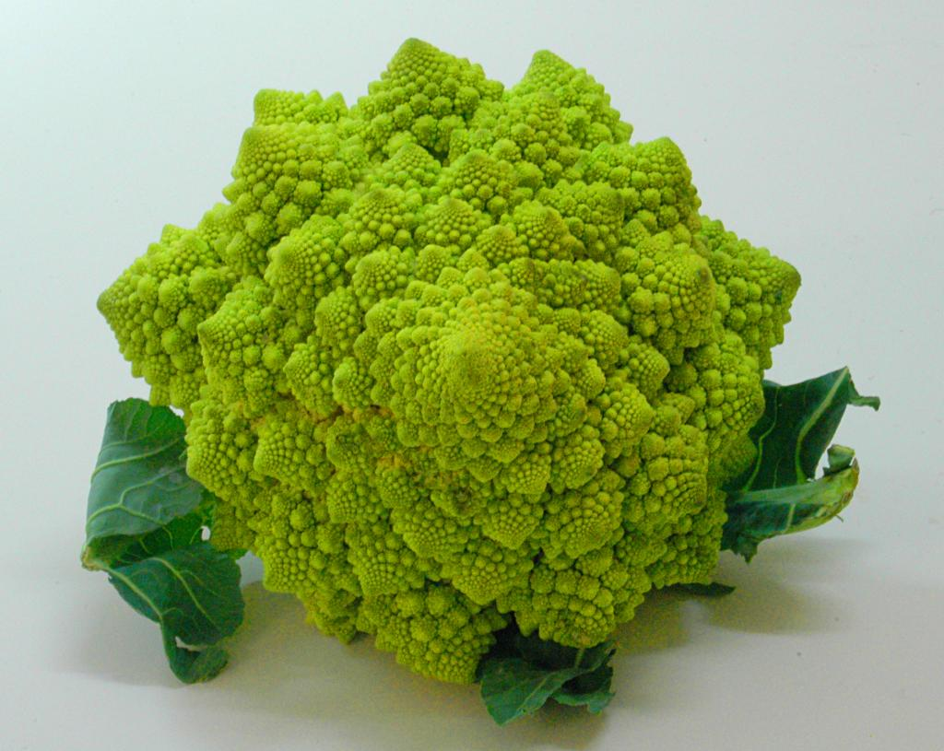

Slide 169
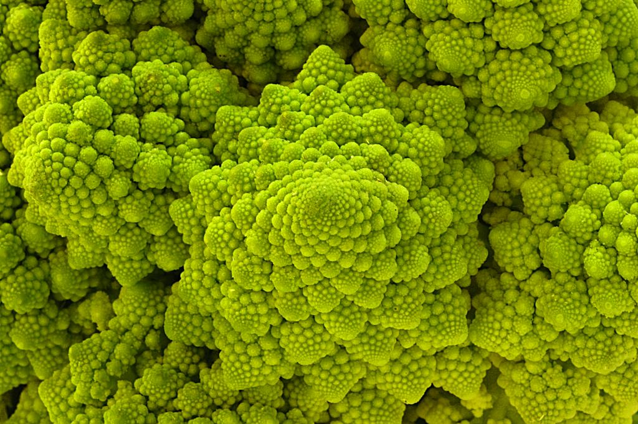
Are these rules for real?
Yes... and no.

Slide 170
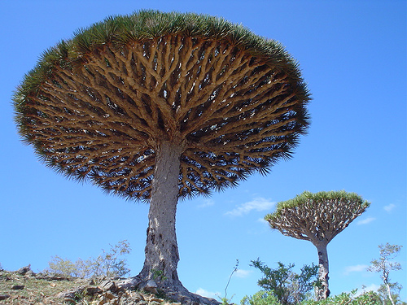
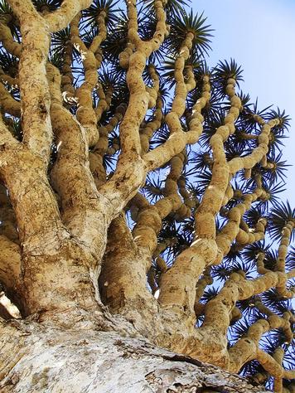
Dragon's-blood Tree

Slide 171
There still has to be a base case…

Slide 172
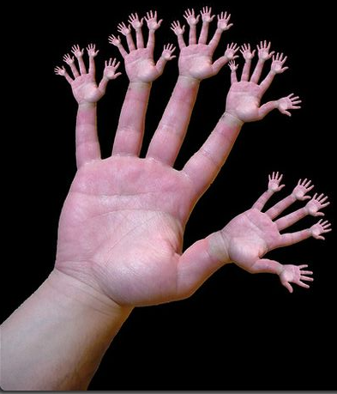
or else!

Slide 173
Recursive design…
fun! easy!?
(1) Program the base case.
(2) Find the self-similarity.
cool!
(3) Do one step!
indexing and slicing
(4) Delegate the rest to recursion…
Aha!

Slide 174
One step?
…is easy to do with Python
s = 'aliens'
s[0]
How do we get at the initial character of s?
How do we get at ALL THE REST of s?
s[ ]
'liens'
L = [ 42, 21 ]
L[0]
How do we get at the initial element of L?
L[ ]
How do we get at ALL THE REST of L?
[ 21 ]

Slide 175
Recursive design #1
'cs5'
def mylen(s):
""" input: any string, s
output: the number of characters in s
"""
if :
else:
base case test!
return
return
Ask yourself:
"How could I make use of the length of something smaller than s?" Then do!

Slide 176
… complete
def mylen(s):
""" input: any string, s
output: the number of characters in s
"""
if s == '':
return 0
else:
return 1 + mylen(s[1:])
There's not much len left here!

Slide 177
def mylen(s):
if s == '':
return 0
else:
return 1 + mylen(s[1:])
Behind the curtain:
how recursion works...
mylen('cs5')
1 + mylen('s5')
1 + 1 + mylen('5')
1 + 1 + 1 + mylen('')
1 + 1 + 1 + 0

Slide 178
Looking behind the curtain…
http://www.pythontutor.com/visualize.html

Slide 179
Design #2
[1,4,3,42,-100,7]
def mymax(L):
""" input: a NONEMPTY list, L
output: L's maximum element
"""
if :
elif :
len(L)==1
base case test!
return
another case…
return
else:
return

Slide 180
Design #2
def mymax(L):
""" input: a NONEMPTY list, L
output: L's maximum element
"""
if len(L) == 1:
return L[0]
elif L[0] < L[1]:
return mymax( L[1:] )
else:
return mymax( L[0:1] + L[2:] )
Hey - do I get a slice?!

Slide 181
def mymax(L):
if len(L) == 1:
return L[0]
elif L[0] < L[1]:
return mymax( L[1:] )
else:
return mymax( L[0:1]+L[2:] )
base case
drop 1st
drop 2nd
mymax( [1,4,3,42,-100,7] )
mymax( [4,3,42,-100,7] )
mymax( [4,42,-100,7] )
mymax( [42,-100,7] )
mymax( [42,7] )
mymax( [42] )
42

Slide 182
power(2,5) == 32.0
Try it!
sajak('wheel of fortune') == 6
What about y? You decide…
in general:
def power(b,p):
def sajak(s):
""" returns b to the p power
Use recursion, not **
Inputs: int b, int p:
the base and the power
"""
""" returns the number of vowels
in the input string, s
"""
if s == '':
Base case test
p == 0
if :
Base case test
return
return
elif
elif
return
else:
else:
return
return
Want more power?
Handle negative values of p in an elif.
Want more Pat?
What 7-letter English word w maximizes sajak(w) ?
For example, power(5,-1) == 0.2

Slide 183
power( 2, 5 )
2* power( 2, 4 )
2* 2* power( 2, 3 )
2* 2* 2* power( 2, 2 )
2* 2* 2* 2* power( 2, 1 )
2* 2* 2* 2* 2* power( 2, 0 )
2* 2* 2* 2* 2* 1
32

Slide 184
sajak( 'eerier' )
1+ sajak( 'erier' )
1+ 1+ sajak( 'rier' )
1+ 1+ 0+ sajak( 'ier' )
1+ 1+ 0+ 1+ sajak( 'er' )
1+ 1+ 0+ 1+ 1+ sajak( 'r' )
1+ 1+ 0+ 1+ 1+ 0+ sajak( '' )
1+ 1+ 0+ 1+ 1+ 0+ 0
4

Slide 185
def power(b,p):
""" inputs: base b and power p (an int)
implements: b**p
"""
if p == 0:
return 1.0
elif p < 0:
return ____________________
else:
return b * power(b,p-1)
Recursion is power!

Slide 186
# of vowels in s
sajak(s):
D
E
S
I
G
N
When there are no letters, there are ZERO vowels
Base case?
Rec. step?
Look at the initial character.
if s[0] is NOT a vowel, the answer is
sajak( s[1:] )
if s[0] is a vowel, the answer is
1 + sajak( s[1:] )

Slide 187
def sajak(s):
if s == '':
return 0
elif s[0]=='a' or s[0]=='e' or…
Is s[0] a vowel?
but how to check for vowels?

Slide 188
Python is… in
I guess Python's the in thing
>>> 'i' in 'team'
False
>>> 'cs' in 'physics'
True
>>> 'i' in 'alien'
True
>>> 3*'i' in 'alien'
False
>>> 42 in [41,42,43]
True
>>> 42 in [[42], '42']
False

Slide 189
let's input 'eerier' for s
def sajak(s):
if len(s) == 0:
return 0
elif s[0] in 'aeiou':
return 1 + sajak(s[1:])
else:
return 0 + sajak(s[1:])
Base Case
if s[0] IS a vowel, the answer is
1 + the # of vowels in the rest of s
Recursive Cases
if s[0] is NOT a vowel, the answer is just
the number of vowels in the rest of s

Slide 190
The key to understanding recursion is, first, to understand recursion.
- a former CS 5 student
It's the eeriest!
Good luck with Homework #1
tutors @ LAC W/Th/F/Sa/Su

Slide 191
Recursion's challenge?
You need to see BOTH the self-similar pieces AND the whole thing simultaneously!
Nature prefers recursion, too!

Slide 193
Are these rules for real?
Yes... and no.

Slide 194
Dragon's-blood Tree

Slide 195
There still has to be a base case…

Slide 196
or else!

