Slide 1


CCSC Showcase
NSF Funding Opportunities for CS Faculty
Mike Erlinger (mike@cs.hmc.edu)
Paul Tymann (ptymann@nsf.gov)
March 21,2020

Slide 2
And a word from my sponsor….
All information provided here represents the opinions of individual Program Officers and former Rotators
The only official source for NSF policy is published materials
http://nsf.gov/

Slide 3
Choosing the Right Program/ Funding Opportunity

Slide 4
Division of Undergraduate Education (DUE)
ATE (NSF 18-571) -- $66 Million, 45-75 Awards
  Focuses on the education of technicians to meet workforce demands in existing and emerging advanced technological fields.
IUSE: EHR (NSF 19-601) -- $63 Milllion, 105 Awards
  Works to improve the effectiveness of undergraduate STEM education, to educate students to become leaders and innovators in STEM, and to provide a foundation in scientific literacy for all students.
HSI Program (NSF 19-540) -- $16 Million, 15 Awards
  Supports building capacity and improving undergraduate STEM education at Hispanic-serving institutions
Noyce (NSF 17-541) -- $58 Million, 55-70 Awards
  Supports talented STEM majors and STEM professionals to become K-12 STEM teachers.
S-STEM (NSF 20-526) $70-95 Million, 60-80 Awards
  Supports institutional scholarship programs for full-time, academically-talented STEM students with demonstrated financial need.

Slide 5
Division of Human Resource Development (HRD)
Alliances for Graduate Education and the Professoriate (NSF 16-552)
  Improve pathways to the professoriate for historically underrepresented minority doctoral students (including those with disabilities), postdoctoral fellows and faculty
Centers of Research Excellence in Science and Technology (NSF 18-509)
  Enhance the research capabilities of MSIs (Minority Serving Institutions) through the establishment of centers with collaborating partners that integrate education and research
HBCU-Undergraduate Program (NSF 18-522)
  Evidence-based, innovative models and approaches to nourish improvements in the preparation and STEM workforce career success of HBCU undergraduates
Louis Stokes Alliances for Minority Participation (NSF 17-579)
  Alliances that implement strategies that result in the graduation of well-prepared, highly-qualified underrepresented students who pursue graduate studies or careers in STEM
Tribal Colleges and Universities Program (NSF 18-546)
  Awards to Tribal Colleges and Universities, Alaska Native-serving institutions, and Native Hawaiian-serving institutions to promote STEM education and research

Slide 6
Other EHR Programs
EHR Core Research (ECR, NSF 19-508) -- $53 Million, 13 EDU, 35 Small, 25 Medium
  Focuses on fundamental research (basic research or use-inspired basic research) that advances knowledge in one or more of the three Research Tracks: Research on STEM Learning and Learning Environments, Research on Broadening Participation in STEM fields, and Research on STEM Workforce Development
  Associated Dear Colleague Letters
NSF 19-044: Fundamental Discipline-Based Education Research (DBER) Focused on Undergraduate and Graduate STEM Education within the EHR Core Research (ECR) Program
NSF 19-033: Research to Improve STEM Teaching and Learning, and Workforce Development for Persons with Disabilities
NSF 19-035: Fundamental Research on Equity, Inclusion, and Ethics in Postsecondary Academic Workplaces and the Academic Profession within the EHR Core Research Program
NSF 19-025: STEM Workforce Development Using Flexible Personal Learning Environments
NSF 19-036: Developing and Testing New Methodologies for STEM Learning Research, Research Syntheses, and Evaluation

Slide 7
Secure and Trustworthy Cyberspace (SaTC)
NSF’s flagship research program for inter-disciplinary, foundational research on security and privacy.
SaTC views cybersecurity and privacy as a socio-technical problem.
SaTC seeks new ways to design, build and operate cyber systems, protect existing infrastructure, and motivate and educate individuals about cybersecurity.
SaTC currently manages 924 active awards.
CISE
SBE
Computer & Information Science & Engineering
Social, Behavioral, and Economic Sciences
EHR
MPS
Education and Human Resources
Math and Physical Sciences
ENG
Engineering

Slide 8






















Active Awards in Diverse Topic Areas:
Authentication
Biometrics
Cryptography
Applied
Cyber -
Physical
Systems
Cybersecurity
Education
Theory
Data Science
Hardware Security Design
Information Authenticity
Formal
Methods
Hardware
Security
Architecture
Intrusion Detection
Language-
Based
Security
Mathematics
& Statistics
Networking
Privacy
Wired
Applied
Theory
Wireless
Social, Behavioral Economic Sciences
Transition to Practice (TTP)
Usability and Human Interaction
Software
Systems

Slide 9
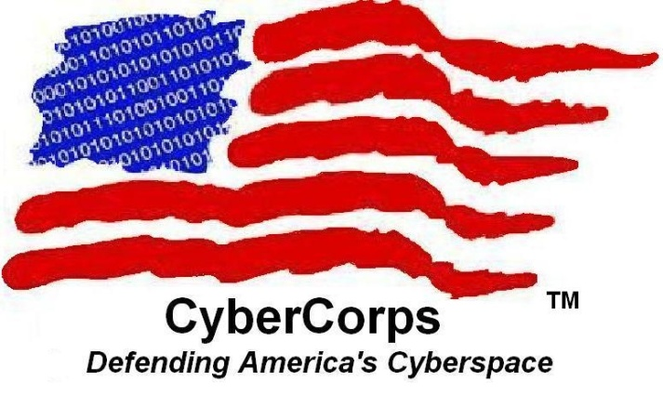
NSF CyberCorps®:
NSF 19-521 -- $15m, 8 to 12
Scholarship for Service (SFS) Program
GOALS
ELIGIBILITY
Increase the number of qualified employees working for Federal, State, Local, and Tribal governments in cybersecurity
Increase the capacity of US education enterprise to produce professionals in cybersecurity
Institution: National CAE/CD designation or offers coherent formal cybersecurity program
Student: US citizen or Permanent Resident, enrolled in cybersecurity program (full time)

Slide 10
CS4All
NSF 20-539
Computer Science for All: Researcher Practitioner Partnerships (RPP)
To provide all U.S. students the opportunity to participate in CS/CT education in school at the K-12 level.
  High school teachers: preparation, professional development (PD) and ongoing support that CS teachers need to teach rigorous CS courses, and
  K-8 teachers: the instructional materials and preparation they need to integrate CS/CT into their teaching.
10

Slide 11
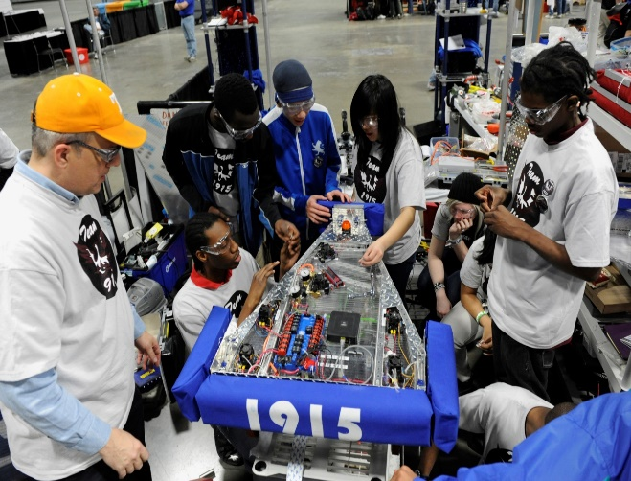
ITEST
NSF 19-583
ITEST is an applied research and development program designed to broaden participation in STEM/ICT careers and career pathways through providing pre-K through 12th grade youth with technology-rich learning experiences in formal or informal settings.

Slide 12
Other Cross-Directorate Programs
IUSE: CUE (NSF 19-546) $4.5 Million, 12-15 Awards
  Supports efforts to envision the role of computing in interdisciplinary education
Harnessing the Data Revolution: Data Science Corps (NSF 19-546)
  Building capacity in data science instruction across the undergraduate spectrum
Future of Work at the Human-Technology Frontier (NSF 20-515)
  Supports efforts to understand and integrate artificial intelligence into the training of the future workforce
National Artificial Intelligence Research Institutes (NSF 20-503)
  Inter-agency AI Institutes
  Accelerating Research, Transforming Society, and Growing the American Workforce

Slide 13
CCSC Showcase
Preparing a Competitive Proposal

Slide 14
Remember Only This!!!
Write to the solicitation
Grant writing is not an exercise in creative writing!!

Slide 15
Study Solicitation
Emphasis
  S-STEM – “The S-STEM program provides Institutions of Higher Education (IHEs) with funds for scholarships to encourage and enable low-income academically talented students with demonstrated financial need to enter the workforce or graduate study following completion of associate, baccalaureate, or graduate degrees in S-STEM eligible disciplines.
Hidden Requirements
  S-STEM - “Successful projects must include involvement of the Offices of Financial Aid, Student Services, and Institutional Research [2], [5], [13], [18], [19].”
  CSforAll – “All proposals will be evaluated on the two additional Broadening Participation Criteria specific to this solicitation (see Section V.A, Project Description, below).”
Understand References
  S-STEM – “Proposals should include a literature review that establishes the basis for the proposed project activities along with a description of how the project plans to generate knowledge about student success and degree attainment in STEM”
  IUSE – “replication or adaptation studies are encouraged to foster propagation of evidence-based STEM teaching and learning approaches in new environments. The 2018 Companion Guidelines on Replication & Reproducibility in Education Research describes conceptual replication as studies that “seek to determine whether similar results are found when certain aspects of a previous study’s method and/or procedures are systematically varied."

Slide 16
Study Solicitation
Proposal Outline
S-STEM – “The proposal should include, within the project description (limited to 15 single-spaced pages), the following:
Results from prior NSF support, with particular emphasis on any prior S-STEM or STEP awards;
  Statement of the project objectives and plans;
  Discussion of the project's significance, including demographic information and rationale for the number of scholarships and the scholarship amount requested;
  Statement and justification of the annual and total number of unique students who will be awarded scholarships over the duration of the award period, the number of scholarships awarded annually, the total number of scholarships awarded for the award period, the duration of the scholarship, and the annual and maximum amount of the scholarship for a scholarship recipient;
  Discussion of activities on which the project builds (particularly connections to any previous or current S-STEM or STEP awards at the institution);
  Description of the management plan, including discussion of the role of faculty in the disciplines in the operation of the project;
  Outline of the student selection process and criteria;
  Description of the implementation and testing of curricular and co-curricular activities, student support services and programs, and their impact on students;
  Contribution to the knowledge base on how factors or evidence-based practices affect student success and degree attainment in STEM;
  Evidence of the quality of the institution's educational programs;
  Plans for project evaluation (formative and summative); and
  Plans for dissemination.

Slide 17

Billiards

Slide 18
Do Your Homework
A Rationale for Your Approach
Local data to support and justify the problem
Evidence that you know what others have done and how the proposed work fits in - Goggle and NSF Awards are your friend
Evidence/argument for impact – locally, broadly -- avoid “Drive By Broader Impacts”

Slide 19
Well Designed Evaluation Plan
Recognize that most CS Educators are NOT experienced in CS Education Research
Conducted by a credible/objective evaluator
Clearly tied to project objectives and outcomes
Includes both formative and summative components
Uses appropriate methods/instruments

Slide 20
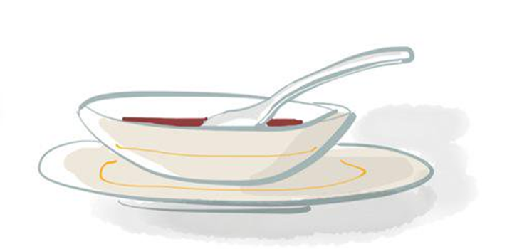
Research vs. Evaluation
Research
  What happens to the soup’s flavor when I use different ingredients?
  How does the rate of cooling change when I use different bowls?
Evaluation
  Did I use appropriate procedures to make the soup?
  Did I adequately consider the possible ingredients I might use?
20

Slide 21
Detailed Project Management Plan
Timeline for major project activities
Description of responsibilities of project personnel
Evidence of expertise of project personnel to carry out proposed work
Reviewers want to be convinced that you have a well thought out plan and assigned tasks. In my experience, funded proposals have a table with a clear and pointed description.
21

Slide 22
Means of Sustaining & Disseminating
Evidence of institutional commitment
Details on which activities will be sustained
How will you share results/promote dissemination?
  Active dissemination over passive,
  Everyone has a web page, can you do something different
22

Slide 23
Proposal Writing Guidelines
Follow the solicitation and the Award Policies and Procedures Guide (PAPPG)
  Adhere to page, font size, and margin limitations
    Use allotted space but don’t pad the proposal
  Follow suggested (or implied) organization
  Use appendices sparingly (check solicitation to see if allowed)
  Include letters showing commitments from others
    Avoid form letters
23

Slide 24
Review
Pay attention to details
  Letters of commitment
  References
  …
Review your proposal before submitting
  Spell/Grammar Check
  Proofread, proofread, proofread what is in Fastlane
Have someone not involved in the project review the proposal
24

Slide 25

Don’t Wait!!

Slide 26
Questions…
26

Slide 27
Contact Information
Mike Erlinger
mike@cs.hmc.edu
Paul Tymann:
  ptymann@nsf.gov
  703-292-9670
27

